Slide 1
More on Functions
Genome 559: Introduction to Statistical and Computational Genomics
Elhanan Borenstein

Slide 2
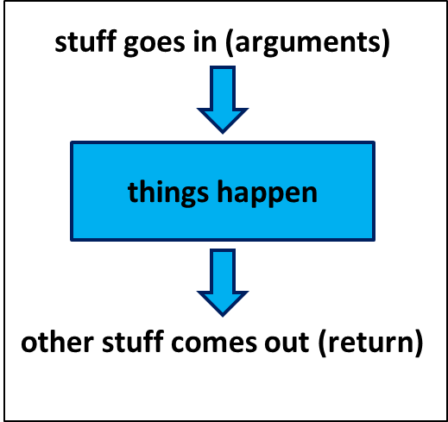
A quick review
Functions:
  Reusable pieces of code (write once, use many)
  Take arguments, “do stuff”, and (usually)
  return a value
  Use to organize & clarify your code, reduce code duplication
Defining a function:
Using (calling) a function:
def <function_name>(<arguments>):
<function code block>
<usually return something>
<function defined here>
<my_variable> = function_name(<my_arguments>)

Slide 3
A close analogy is the
mathematical function
A Python Function
A mathematical Function
x is an
argument
arguments go in
things happen
the function itself
return value comes out
y is the return value
Notes:
improve

Slide 4
A quick example
import sys
def makeDict(fileName):
myFile = open(fileName, "r")
myDict = {}
for line in myFile:
fields = line.strip().split("\t")
myDict[fields[0]] = float(fields[1])
myFile.close()
return myDict
FirstFileName = sys.argv[1]
FirstDict = makeDict(FirstFileName)
SecondFileName = sys.argv[2]
SecondDict = makeDict(SecondFileName)
…
FlyGenesDict = makeDict(“FlyGeneAtlas.txt”)
Write once
Use many times

Slide 5
A note about namespace
import sys
def makeDict(fileName):
myFile = open(fileName, "r")
myDict = {}
for line in myFile:
fields = line.strip().split("\t")
myDict[fields[0]] = float(fields[1])
myFile.close()
return myDict
FirstFileName = sys.argv[1]
FirstDict = makeDict(FirstFileName)
SecondFileName = sys.argv[2]
SecondDict = makeDict(SecondFileName)
…
FlyGenesDict = makeDict(“FlyGeneAtlas.txt”)
Write once
Use many times

Slide 6
A note about namespace
import sys
def makeDict(fileName):
myFile = open(fileName, "r")
myDict = {}
for line in myFile:
fields = line.strip().split("\t")
myDict[fields[0]] = float(fields[1])
myFile.close()
return myDict
FirstFileName = sys.argv[1]
FirstDict = makeDict(FirstFileName)
SecondFileName = sys.argv[2]
SecondDict = makeDict(SecondFileName)
…
FlyGenesDict = makeDict(“FlyGeneAtlas.txt”)
Write once
Use many times

Slide 7
Returning values
Check the following function:
What does this function do?
# This function …
# …
def CalcSum(a_list):
sum = 0
for item in a_list:
sum += item
return sum

Slide 8
Returning values
Check the following function:
What does this function do?
# This function calculates the sum
# of all the elements in a list
def CalcSum(a_list):
sum = 0
for item in a_list:
sum += item
return sum
>>> my_list = [1, 3, 2, 9]
>>> print CalcSum(my_list)
15

Slide 9
Returning more than one value
Let’s be more ambitious:
How can we return both values?
# This function calculates the sum
# AND the product of all the
# elements in a list
def CalcSumAndProd(a_list):
sum = 0
prod = 1
for item in a_list:
sum += item
prod *= item
return ???

Slide 10
Returning more than one value
We can use a list as a return value:
# This function calculates the sum
# AND the product of all the
# elements in a list
def CalcSumAndProd(a_list):
sum = 0
prod = 1
for item in a_list:
sum += item
prod *= item
return [sum, prod]
>>> my_list = [1, 3, 2, 9]
>>> print CalcSumAndProd(my_list)
[15, 54]
List assignment
>>> res = CalcSumAndProd(my_list)
multiple assignment
>>> [s,p] = CalcSumAndProd(my_list)

Slide 11
Required Arguments
How about this?
def printMulti(text, n):
for i in range(n):
print text
>>> printMulti(“Bla”,4)
Bla
Bla
Bla
Bla
What happens if I try to do this:
>>> printMulti("Bla")
Traceback (most recent call last):
File "<stdin>", line 1, in <module>
TypeError: printMulti() takes exactly 2 arguments (1 given)

Slide 12
Default Arguments
Python allows you to define defaults for various arguments:
def printMulti(text, n=3):
for i in range(n):
print text
>>> printMulti(“Bla”,4)
Bla
Bla
Bla
Bla
>>> printMulti(“Yada”)
Yada
Yada
Yada

Slide 13
Default Arguments
This is very useful if you have functions with numerous arguments/parameters, most of which will rarely be changed by the user:
You can now simply use:
Instead of:
def runBlast(fasta_file, costGap=10, E=10.0, desc=100,
max_align=25, matrix=“BLOSUM62”, sim=0.7, corr=True):
<runBlast code here>
>>> runBlast(“my_fasta.txt”)
>>> runBlast(“my_fasta.txt”,10,10.0,100,25,“BLOSUM62”,0.7, True)

Slide 14
Keyword Arguments
You can still provide values for specific arguments using their label:
def runBlast(fasta_file, costGap=10, E=10.0, desc=100,
max_align=25, matrix=“BLOSUM62”, sim=0.7, corr=True):
<runBlast code here>
…
>>> runBlast(“my_fasta.txt”, matrix=“PAM40”)

Slide 15
Code like a pro …
TIP
OF THE DAY

Slide 16
Code like a pro …
TIP
OF THE DAY
Write comments!

Slide 17
Why comments
TIP
OF THE DAY
Uncommented code = useless code
Comments are your way to communicate with:
  Future you!
  The poor bastard that inherits your code
  Your users (most academic code is open source!)
At minimum, write a comment to explain:
  Each function: target, arguments, return value
  Each File: purpose, major revisions
  Non-trivial code blocks
  Non-trivial variables
  Whatever you want future you to remember

Slide 18
Best (real) comments ever
# When I wrote this, only God and I understood what I was doing
# Now, God only knows
# I dedicate all this code, all my work, to my wife, Darlene,
# who will have to support me and our three children and the
# dog once it gets released into the public.
# I am not responsible of this code.
# They made me write it, against my will.
# drunk. fix later
# Magic. Do not touch.
# I am not sure if we need this, but too scared to delete.
# Dear future me. Please forgive me.
# I can't even begin to express how sorry I am.
# no comments for you!
# it was hard to write so it should be hard to read
# somedev1 - 6/7/02 Adding temporary tracking of Logic screen
# somedev2 - 5/22/07 Temporary my ass

Slide 19
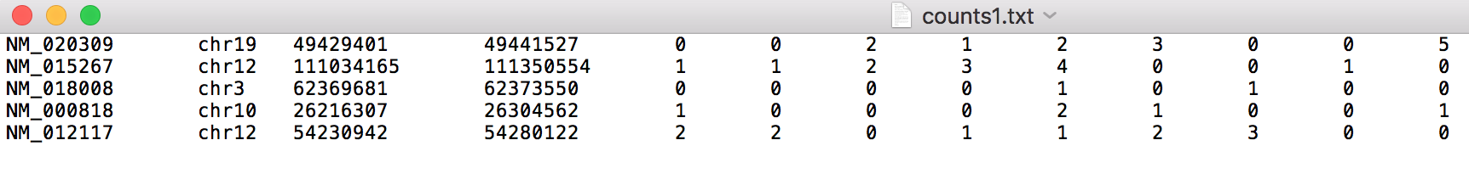
Interactive problem
Refseq
ID
Chrom
Start
Stop
Each column is a single cell
Write a program norm-expression.py that calculates length normalized transcript expression in counts1.txt.
Your program should include a function that takes three inputs (start, stop, [transcript counts])
Make your program print ID <tab> (average # of transcripts per cell / kb of transcript) to the terminal for each transcript detected
$ python norm-exp.py counts1.txt
NM_020309 0.119
NM_015267 0.004
NM_018008 0.057
NM_000818 0.006
NM_012117 0.032
←Expected outcome

Slide 20
Interactive problem – raw code
import sys
def get_len_norm_expr(start, stop, counts):
'''This function calculates average single cell expression count per kb'''
trans_len = int(stop) - int(start)
trans_len_kb = trans_len / 1000
for i in range(0, len(counts), 1):
counts[i] = int(counts[i])
avg_exp = sum(counts) / len(counts)
return avg_exp / trans_len_kb
# Open file for reading
in_file_name = sys.argv[1]
in_file = open(in_file_name, "r")
# Interate through input file contents, passing required info to function
# and printing result to terminal.
for line in in_file:
ID = line.strip().split("\t")[0]
trans_start = line.strip().split("\t")[2]
trans_stop = line.strip().split("\t")[3]
trans_counts = line.strip().split("\t")[4:]
print('%s\t%0.3f'\
% (ID, get_len_norm_expr(trans_start, trans_stop, trans_counts)))

Slide 21
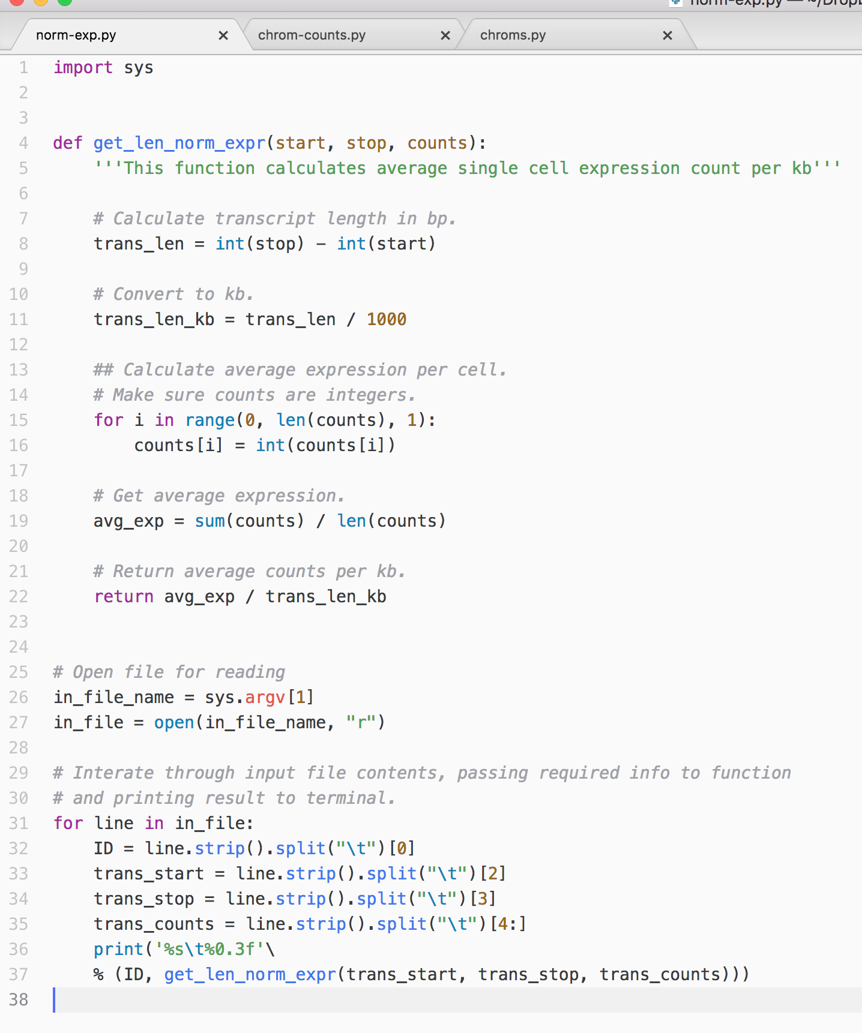
Interactive problem – with comments

Slide 22
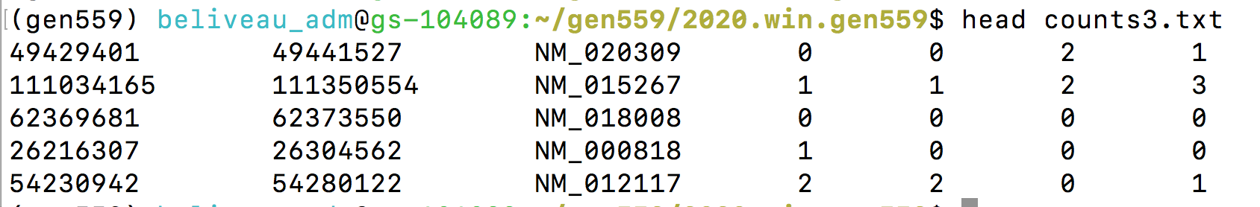
Sample problem #1
Refseq
ID
Each column is a single cell
Start
Stop
Write a program norm-exp3.py that calculates length normalized transcript expression in counts3.txt.
Your program should include a function that takes three inputs (start, stop, [transcript counts])
Make your program print ID <tab> (average # of transcripts per cell / kb of transcript) to the terminal for each transcript detected
$ python norm-exp3.py counts3.txt
NM_020309 0.062
NM_015267 0.006
NM_018008 0.000
NM_000818 0.003
NM_012117 0.025
←Expected outcome

Slide 23
Sample problem #1 – raw code
import sys
def get_len_norm_expr(start, stop, counts):
'''This function calculates average single cell expression count per kb'''
trans_len = int(stop) - int(start)
trans_len_kb = trans_len / 1000
for i in range(0, len(counts), 1):
counts[i] = int(counts[i])
avg_exp = sum(counts) / len(counts)
return avg_exp / trans_len_kb
# Open file for reading
in_file_name = sys.argv[1]
in_file = open(in_file_name, "r")
# Interate through input file contents, passing required info to function
# and printing result to terminal.
for line in in_file:
ID = line.strip().split("\t")[2]
trans_start = line.strip().split("\t")[0]
trans_stop = line.strip().split("\t")[1]
trans_counts = line.strip().split("\t")[3:]
print('%s\t%0.3f'\
% (ID, get_len_norm_expr(trans_start, trans_stop, trans_counts)))

Slide 24
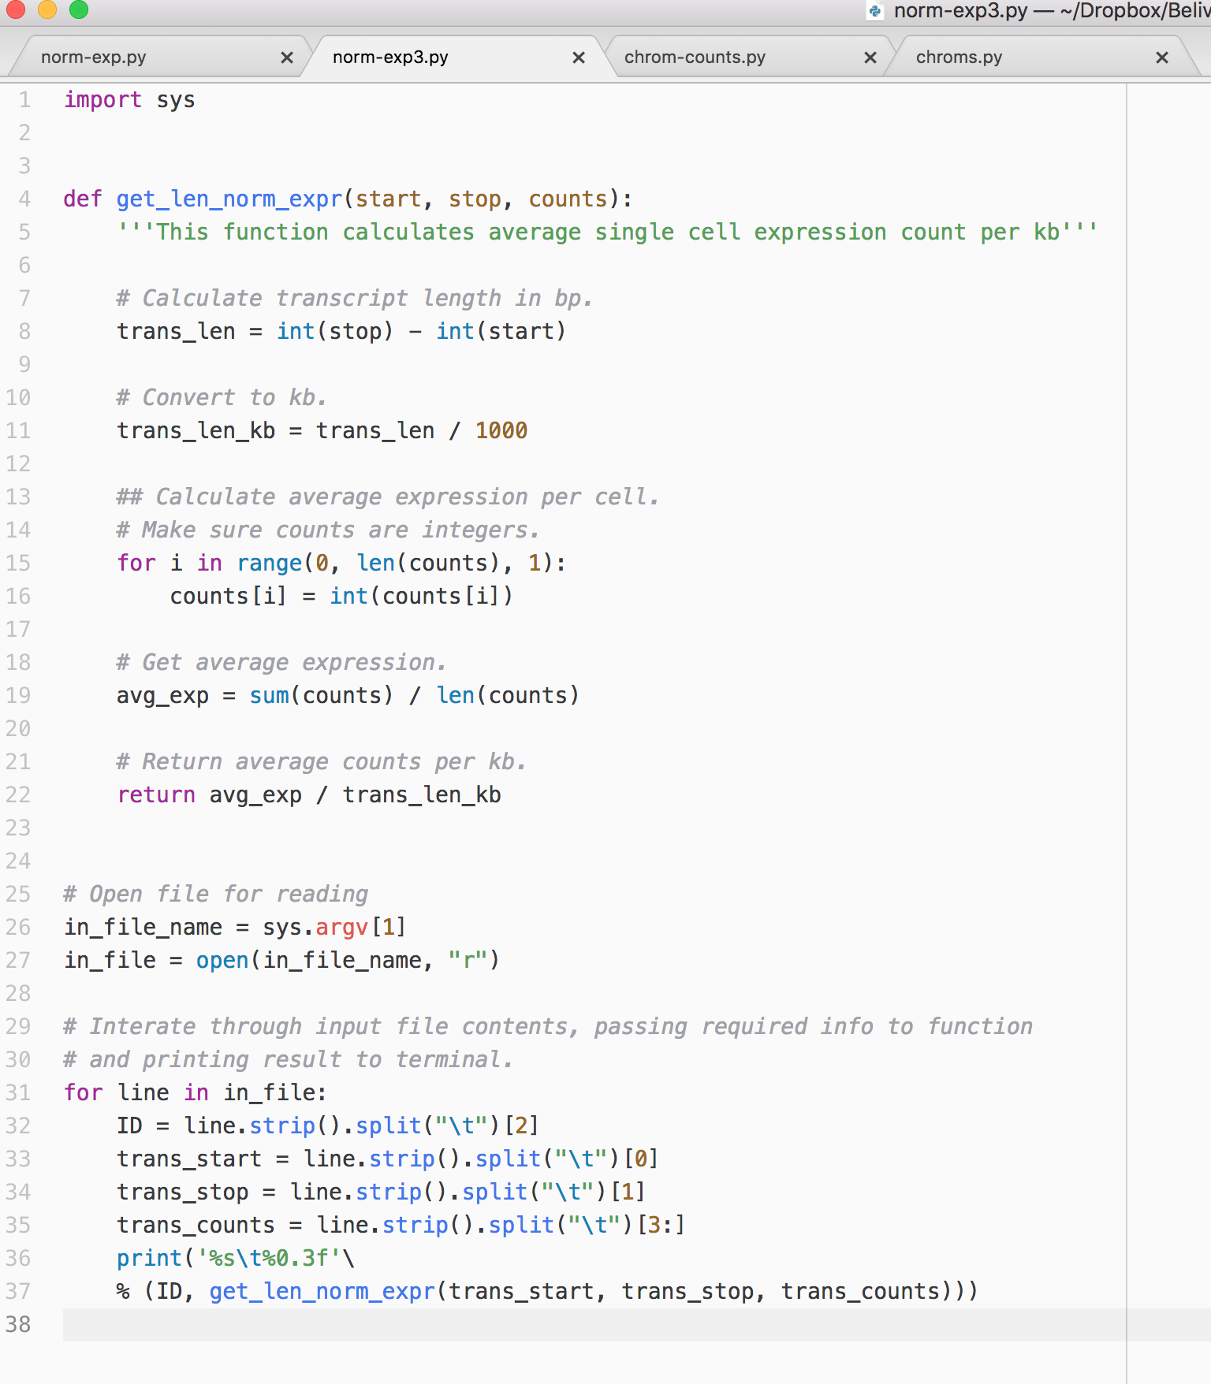
Sample problem #1 – with comments

Slide 25
Sample problem #2
Write a function that calculates the first n elements of the Fibonacci sequence.
  Reminder: In the Fibonacci sequence of numbers, each number is the sum of the previous two numbers, starting with 0 and 1. This sequence begins: 0, 1, 1, 2, 3, 5, 8, 13, 21, 34, 55, 89, 144, 233, 377, 610, 987, …
The function should return these n elements as a list

Slide 26
Solution #2
# Calculate Fibonacci series up to n
def fibonacci(n):
fib_seq = [0, 1];
for i in range(2,n):
fib_seq.append(fib_seq[i-1] + fib_seq[i-2])
return fib_seq[0:n] # Why not just fib_seq?
print fibonacci(10)
[0, 1, 1, 2, 3, 5, 8, 13, 21, 34]

Slide 27
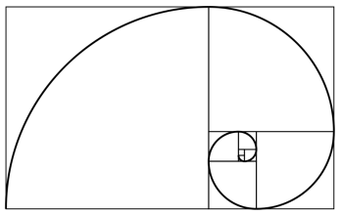
Sample problem #3
Make the following improvements to your function:
Add two optional arguments that will denote alternative starting values (instead of 0 and 1).
  fibonacci(10) → [0, 1, 1, 2, 3, 5, 8, 13, 21, 34]
  fibonacci(10,4) → [4, 1, 5, 6, 11, 17, 28, 45, 73, 118]
  fibonacci(10,4,7) →[4, 7, 11, 18, 29, 47, 76, 123, 199, 322]
Return, in addition to the sequence, also the ratio of the last two elements you calculated (how would you return it?).

Slide 28
Solution #3
# Calculate Fibonacci series up to n
def fibonacci(n, start1=0, start2=1):
fib_seq = [start1, start2];
for i in range(2,n):
fib_seq.append(fib_seq[i-1]+fib_seq[i-2])
ratio = float(fib_seq[n-1])/float(fib_seq[n-2])
return [fib_seq[0:n], ratio]
seq, ratio = fibonacci(1000)
print "first 10 elements:",seq[0:10]
print "ratio:", ratio
# Will print:
# first 10 elements:[0, 1, 1, 2, 3, 5, 8, 13, 21,34]
# ratio: 1.61803398875

Slide 29
Challenge problem
Write your own sort function!
Sort elements in ascending order.
The function should sort the input list in-place
(i.e. do not return a new sorted list as a return value; the list that is passed to the function should itself be sorted after the function is called).
As a return value, the function should return the number of elements that were in their appropriate (“sorted”) location in the original list.
You can use any sorting algorithm. Don’t worry about efficiency right now.

Slide 30
Challenge solution 1
def swap(a_list, k, l):
temp = a_list[k]
a_list[k] = a_list[l]
a_list[l] = temp
def bubbleSort(a_list):
n = len(a_list)
a_list_copy = [] # note: why don't we use assignment
for item in a_list: a_list_copy.append(item)
# bubble sort
for i in range(n):
for j in range(n-1):
if a_list[j] > a_list[j+1]:
swap(a_list, j, j+1) # note: in place swapping
# check how many are in the right place
count = 0
for i in range(n):
if a_list[i] == a_list_copy[i]: count += 1
return count
This is the actual sorting algorithm. Simple!
>>> ls = [1, 3, 2, 15, 7, 4, 8, 12]
>>> print bubbleSort(ls)
2
>>> print ls
[1, 2, 3, 4, 7, 8, 12, 15]

