Slide 1
One Minute Responses
Pace good (x3).
Great.
Going through practice problems together is very helpful
Really enjoyed the interactive session again today!
Going through a problem together, especially the logic needed before starting, was really helpful
Interactive problems are extremely useful because they allow us to see how you think about and set up your code
Good to know, we will keep doing this and also emphasize this kind of thinking as we go through code examples in the practical lecture.
The way we went through the interactive problem seemed counter intuitive because I’m so used to opening the file, parsing it, etc. before doing anything else
Either way is 100% OK. The most important things to focus on are identifying the necessary steps and writing effective code to tackle them.

Slide 2
One Minute Responses cont.
Walking through 1 problem was a little slow
Agreed. Going forward, we can expect to spend less time on any one individual problem.
Can we spend more time on algorithms and theory and less time on programming?
Programming is a core aspect of what this class is about, so we will continue to make it a strong focus. Please feel free to email me about theory/algorithms if there are questions or for extra sources of material.
I’m a bit confused where we are going with the parsimony lecture…
Hopefully today’s lecture will help!
Can you put updated material before class? My powerpoints are often different.
I will try my best to have updated slides up a day in advance.

Slide 3
Parsimony
Small + Large Parsimony & Search Algorithms
Genome 559: Introduction to Statistical and Computational Genomics
Elhanan Borenstein

Slide 4
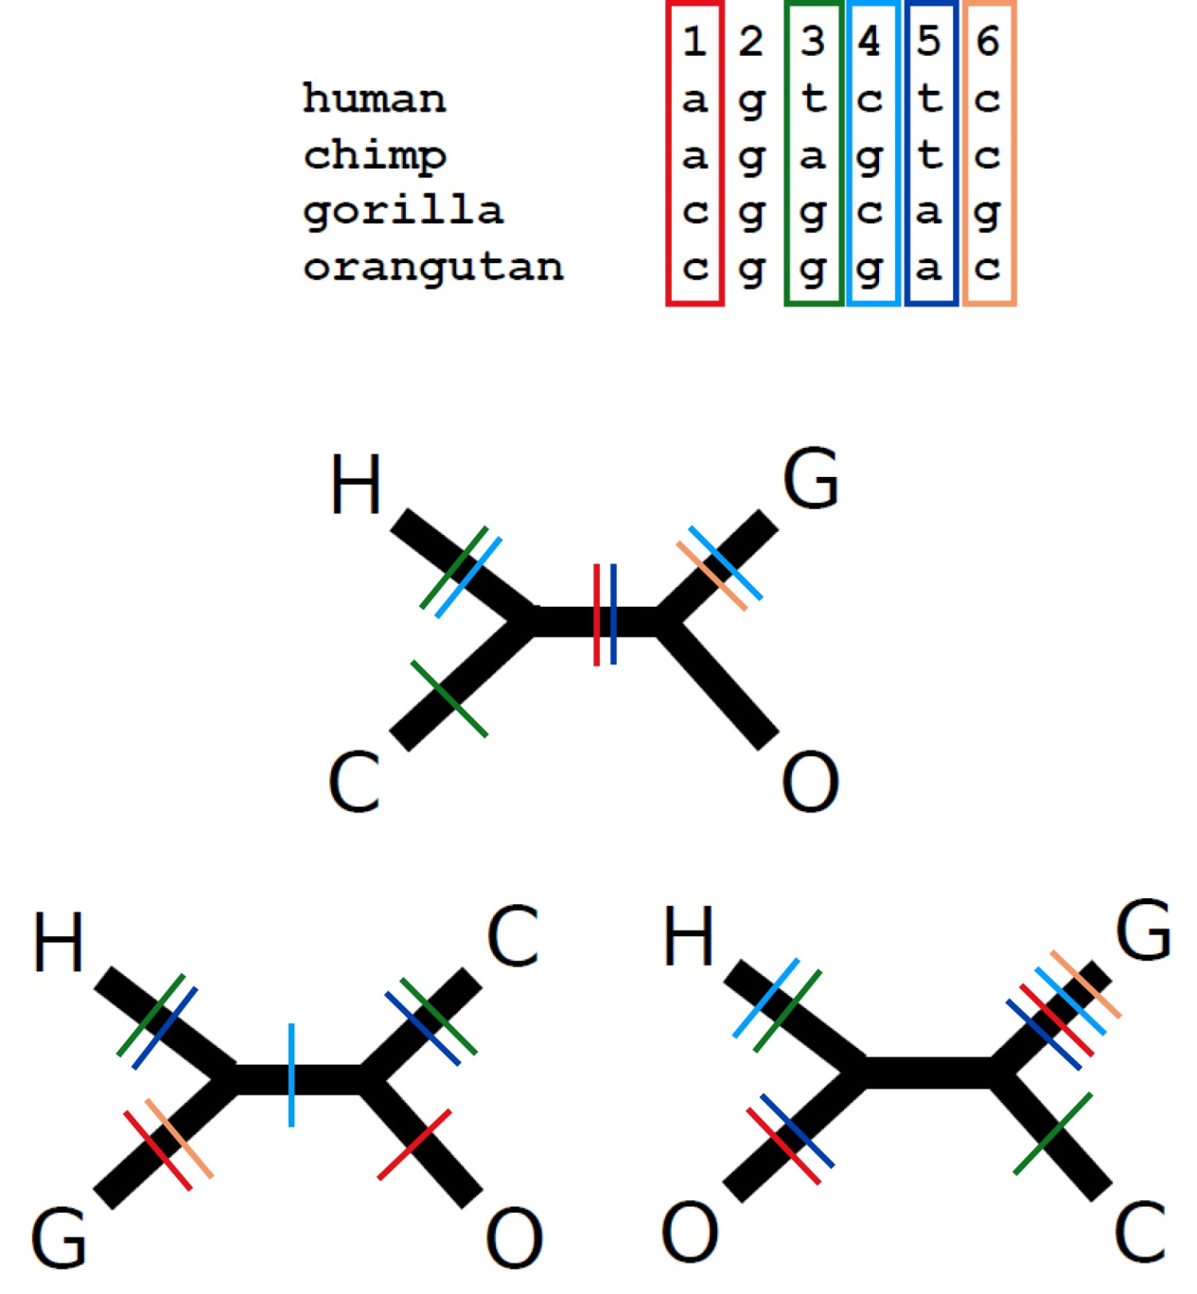
A quick review
The parsimony principle:
  Find the tree that requires the
  fewest evolutionary changes!
A fundamentally different method:
  Search rather than reconstruct
Parsimony algorithm
  Construct all possible trees
  For each site in the alignment and for each tree count the minimal number of changes required
  Add sites to obtain the total number of changes required for each tree
  Pick the tree with the lowest score
Too many!
The small parsimony problem

Slide 5
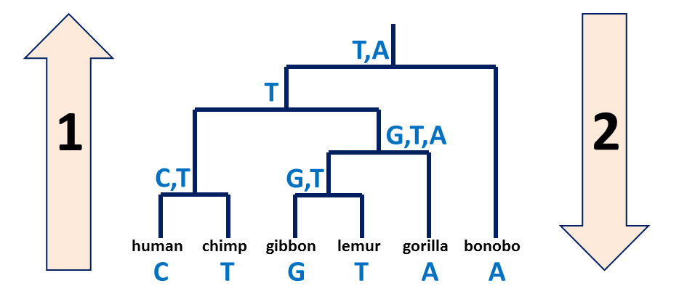
A quick review – cont’
Small vs. large parsimony
  Large parsimony: Find the topology which gives best score
  Small parsimony: Given a tree topology and the state in all the tips, find the minimal number of changes required
Fitch’s algorithm:
  Bottom-up phase: Determine the set of possible states
  Top-down phase: Pick a state for each internal node

Slide 6
1. Fitch’s algorithm: Bottom-up phase
(Determine the set of possible states for each internal node)
Initialization: R_{i} = {s_{i}} for all tips
Traverse the tree from leaves to root (“post-order“)
Determine R_{i} of internal node i with children j, k:
Parsimony-score =
# union operations*
T,A
T
1
G,T,A
C,T
*if you follow procedure exactly as stated
G,T
human
chimp
gibbon
lemur
gorilla
bonobo
Parsimony-score = 4
C
T
G
T
A
A

Slide 7
2. Fitch’s algorithm: Top-down phase
(Pick a state for each internal node)
Pick arbitrary state in R_{root} to be the state of the root ,s_{root}
Traverse the tree from root to leaves (“pre-order”)
Determine s_{i} of internal node i with parent j:
A→T
T,A
Pick A at root, follow rules.
T
2
G,T,A
C,T
G,T
Parsimony-score = 4
T→C
T→G
T→A
human
chimp
gibbon
lemur
gorilla
bonobo
C
T
G
T
A
A

Slide 8
2. Fitch’s algorithm: Top-down phase
(Pick a state for each internal node)
Pick arbitrary state in R_{root} to be the state of the root ,s_{root}
Traverse the tree from root to leaves (“pre-order”)
Determine s_{i} of internal node i with parent j:
T,A
Pick T at root, follow rules.
T
2
G,T,A
T→A
C,T
G,T
Parsimony-score = 4
T→C
T→G
T→A
human
chimp
gibbon
lemur
gorilla
bonobo
C
T
G
T
A
A

Slide 9
2. Fitch’s algorithm: Top-down phase
(Pick a state for each internal node)
Pick arbitrary state in R_{root} to be the state of the root ,s_{root}
Traverse the tree from root to leaves (“pre-order”)
Determine s_{i} of internal node i with parent j:
T,A
Pick T at root, break rules.
T
T→G
2
G,T,A
T→A
C,T
G,T
Parsimony-score = 5
T→C
G→T
G→A
human
chimp
gibbon
lemur
gorilla
bonobo
C
T
G
T
A
A

Slide 10
And now back to the “big” parsimony problem …
How do we find the most parsimonious tree amongst the many possible trees?

Slide 11
Searching tree space
Exhaustive search:
Up to 8-10 leaves (10k-2m unrooted trees, 135k-34m rooted)
Guaranteed results
Branch-and-bound*:
Up to 10-20 leaves
Guaranteed results!!!
* Branch-and-bound is a clever way of ruling out most trees as they are built,
so you can evaluate more trees by exhaustive search.
Heuristic search (e.g. hill-climb):
20+ leaves
May not find correct solution.

Slide 12
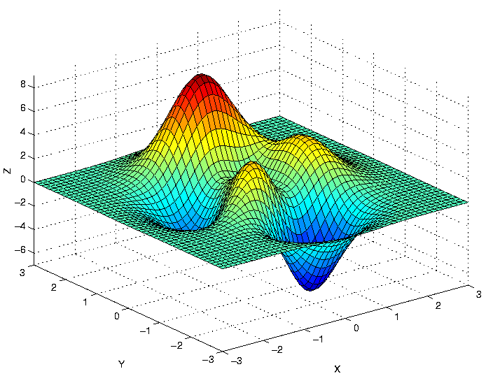
Search space

Slide 13

Hill-climbing

Slide 14
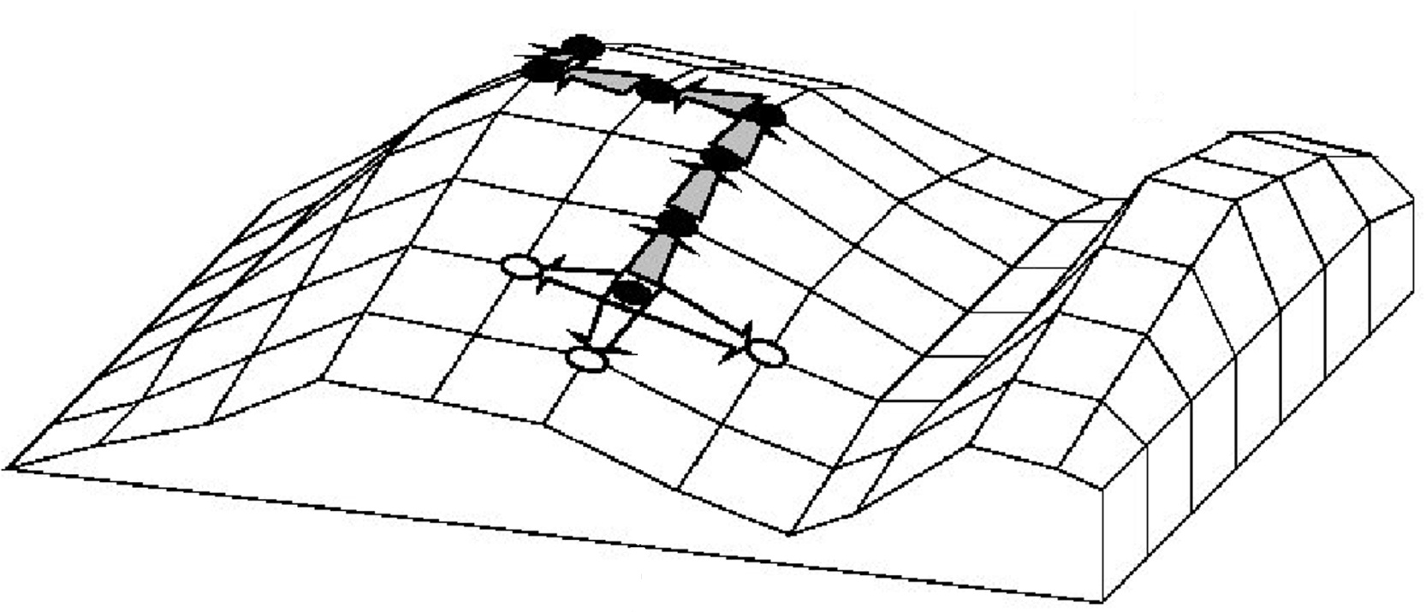
Hill-climbing for searching “best” tree
Final tree
still possible that best tree is here
Parsimony score
Accepted related tree
Different trees
Rejected related tree
Starting tree
A “greedy” algorithm: makes locally optimal choice to try and find global optimum

Slide 15
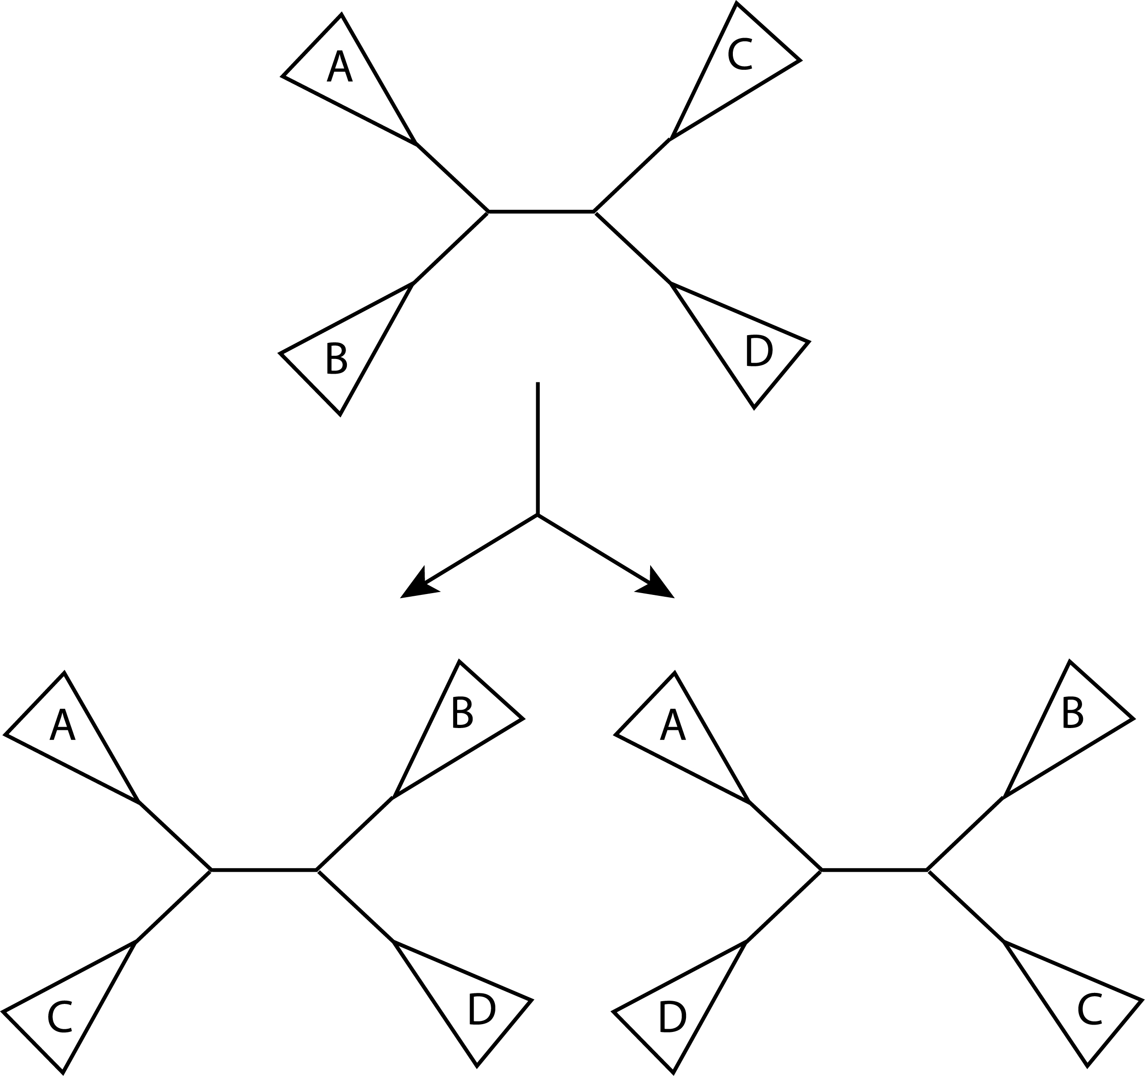
Nearest-Neighbor Interchange (NNI)
Find a tree with some score.
At each internal branch consider the two alternative arrangements of the 4 sub-trees.
Keep the tree that has the best score
(e.g., best parsimony score, which you
can calculate using Fitch’s algorithm)
Repeat.
Sub-tree

Slide 16
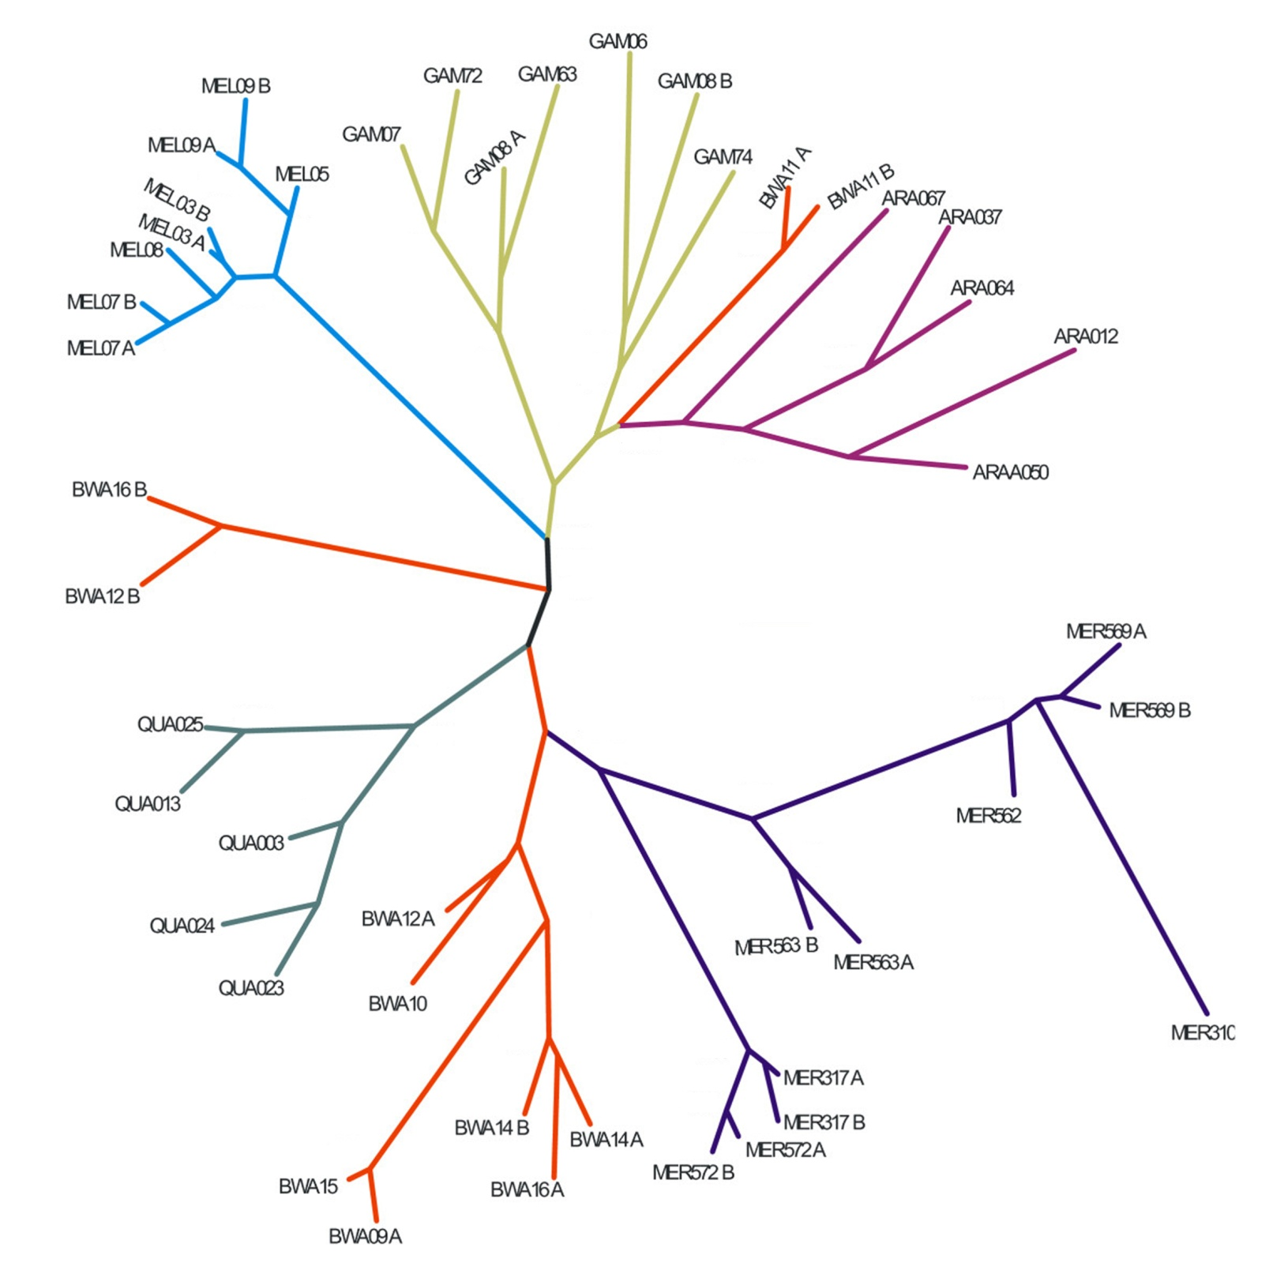
three (of many) places where NNI can be considered

Slide 17
Hill-climbing with NNI
Final tree
still possible that best tree is here
Parsimony score
Accepted NNI tree
Different trees
Rejected NNI tree
Starting tree
A “greedy” algorithm

Slide 18
The parsimony algorithm
Construct all possible trees or search the space of possible trees using NNI hill-climb
For each site in the alignment and for each tree count the minimal number of changes required using Fitch’s algorithm
Add all sites up to obtain the total number of changes for each tree
Pick the tree with the lowest score or search until no better tree can be found

Slide 19
Phylogenetic trees: Summary
Parsimony Trees:
Construct all possible trees or search the space of possible trees
For each site in the alignment and for each tree count the minimal number of changes required using Fitch’s algorithm
Add all sites up to obtain the total number of changes for each tree
Pick the tree with the lowest score
Distance Trees:
Compute pairwise corrected distances.
Build tree by sequential clustering algorithm (UPGMA or Neighbor-Joining).
These algorithms don't consider all tree topologies, so they are very fast, even for large trees.
Maximum-Likelihood Trees:
Tree evaluated for likelihood of data given tree.
Uses a specific model for evolutionary rates (such as Jukes-Cantor).
Like parsimony, must search tree space.
Usually most accurate method but slow.

