Slide 1
Functions
Genome 559: Introduction to Statistical and Computational Genomics
Elhanan Borenstein

Slide 2
A quick review
What are we missing?
  A way to generalized procedures …
  A way to store and handle complex data …
  A way to organize our code …
  Better design and coding practices …

Slide 3
Why functions?
Reusable piece of code
  write once, use many times
    Within your code
    Across several programs
    Across team members
Helps simplify and organize your program
Helps avoid duplication of code

Slide 4
What a function does?
Takes defined inputs (arguments) and may
produce a defined output (return)
stuff goes in (arguments)
things happen
other stuff comes out (return)
Other than the arguments and the return, everything else inside the function is invisible outside the function (variables assigned, etc.). Black box!
The function doesn't need to have a return.
Spoiler: The arguments can be changed and changes are visible outside the function

Slide 5
Jukes-Cantor model
Jukes-Cantor model:
D_{raw} is the raw distance (what we directly measure)
D is the corrected distance (what we want)

Slide 6
Defining a function
define the function and argument(s) names
import math
def jc_dist(rawdist):
if rawdist < 0.75 and rawdist > 0.0:
newdist = (-3.0/4.0) * math.log(1.0 - (4.0/3.0)* rawdist)
return newdist
elif rawdist >= 0.75:
return 1000.0
else:
return 0.0
Do something
return a computed value
def <function_name>(<arguments>):
<function code block>
<usually return something>

Slide 7
Using (calling) a function
<function defined here>
import sys
dist = sys.argv[1]
correctedDist = jc_dist(dist)

Slide 8
Using (calling) a function
<function defined here>
import sys
dist = sys.argv[1]
correctedDist = jc_dist(dist)
AnotherDist = 0.354
AnotherCorrectedDist = jc_dist(AnotherDist)
OneMoreCorrectedDist = jc_dist(0.63)

Slide 9
Using (calling) a function
<function defined here>
import sys
dist = sys.argv[1]
correctedDist = jc_dist(dist)
AnotherDist = 0.354
AnotherCorrectedDist = jc_dist(AnotherDist)
OneMoreCorrectedDist = jc_dist(0.63)
# What about …
jc_dist(0.57)

Slide 10

Once you've written the function,
you can forget about it and just use it!

Slide 11
From “In-code” to Function
Jukes-Cantor distance correction written directly in program:
import sys
import math
rawdist = float(sys.argv[1])
if rawdist < 0.75 and rawdist > 0.0:
newdist = (-3.0/4.0) * math.log(1.0 - (4.0/3.0)* rawdist)
print newdist
elif rawdist >= 0.75:
print 1000.0
else:
print 0.0
Jukes-Cantor distance correction written as a function:
import sys
import math
def jc_dist(rawdist):
rawdist = float(sys.argv[1])
if rawdist < 0.75 and rawdist > 0.0:
newdist = (-3.0/4.0) * math.log(1.0 - (4.0/3.0)* rawdist)
return newdist
elif rawdist >= 0.75:
return 1000.0
else:
return 0.0
Add a function definition
delete - use function argument instead of argv
return value rather than printing it

Slide 12
We've used lots of functions before!
math.log(value)
readline(), readlines(), read()
sort()
split(), replace(), lower()
These functions are part of the Python programming environment (in other words they are already written for you).
Note - some of these are functions attached to objects (and called object "methods") rather than stand-alone functions. We'll cover this later.

Slide 13
Function names, access, and usage
Giving a function an informative name is very important!
Long names are fine if needed:
def makeDictFromTwoLists(keyList, valueList):
def translateDNA(dna_seq):
def getFastaSequences(fileName):
For now, your function will have to be defined within your program and before you use it. Later you'll learn how to save a function in a module so that you can load your module and use the function just the way we do for Python modules.
Usually, potentially reusable parts of your code should be written as functions.
Your program (outside of functions) will often be very short - largely reading arguments and making output.

Slide 14
Sample problem #1
Write a program random-seq.py that generates a random DNA sequence of length N bases.
Use a function to generate the random sequence
Make your program print the random sequence to the terminal
Hint: the random.random() method will be very useful (example usage below)
>>> import random
>>> print(random.random())
0.8837103389761158
>>> print(random.random())
0.18647768377170393
$ python random-seq.py 5
CATAA
$ python random-seq.py 5
GACGC
$ python random-seq.py 10
TGGGCCCAGG
$ python random-seq.py 10
GTCGGGCACA
←Expected outcome

Slide 15
Solution #1 – raw code
import sys
import random
# Define the sequence generation function.
def seq_generate(N):
"""This generates a random DNA sequence of length N bases."""
seq = []
while len(seq) < N:
random_val = random.random()
if random_val < 0.25:
seq.append("A")
elif 0.25 <= random_val < 0.5:
seq.append("T")
elif 0.5 <= random_val <0.75:
seq.append("C")
else:
seq.append("G")
return ''.join(seq)
# Get desired sequence length from user input.
seq_length = int(sys.argv[1])
# Call seq_generate function and print output to terminal.
print(seq_generate(seq_length))

Slide 16
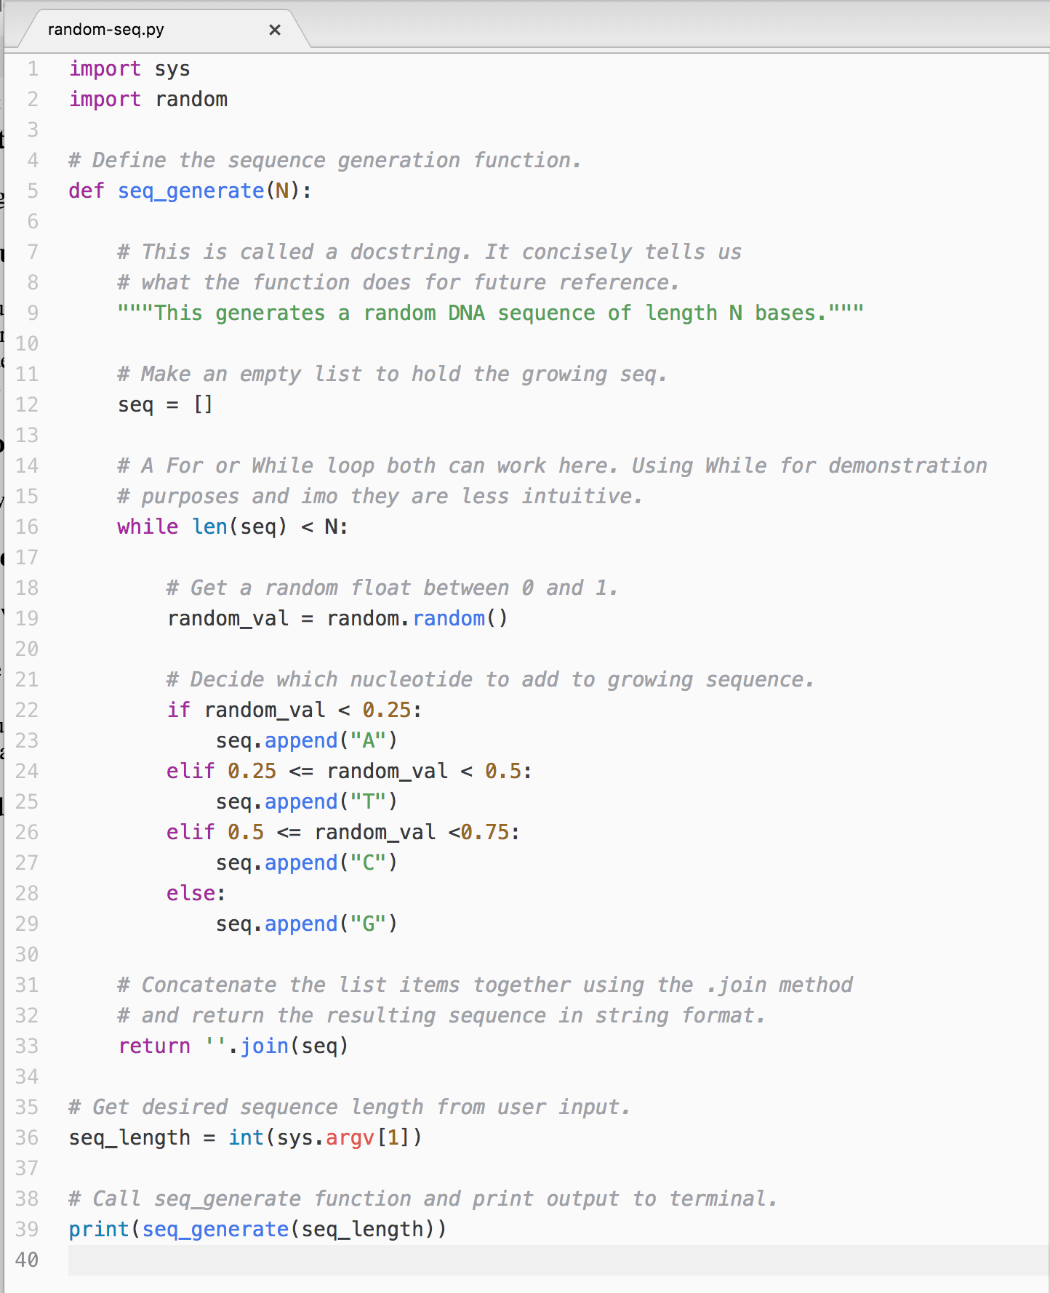
Solution #1 – with comments

Slide 17
Sample problem #2
Write a program seq-sets.py that returns k unique random sequences of length N bases.
Use a function to generate the random sequence
Make your program print the k random sequences to the terminal
Make sure to check your sequences are unique
$ python seq-sets.py 5 3
CGTGG
AGGAA
GACAG
python seq-sets.py 7 2
GAACGCC
AATATAG
$ python seq-sets.py 10 2
CCGTTTGCAT
CACAGAAGTC
←Expected outcome

Slide 18
Solution #2 – raw code
import sys
import random
# Define the sequence generation function.
def seq_generate(N):
"""This generates a random DNA sequence of length N bases."""
seq = []
while len(seq) < N:
random_val = random.random()
if random_val < 0.25:
seq.append("A")
elif 0.25 <= random_val < 0.5:
seq.append("T")
elif 0.5 <= random_val <0.75:
seq.append("C")
else:
seq.append("G")
return ''.join(seq)
# Get desired sequence length from user input.
seq_length = int(sys.argv[1])
# Get desired number of seqs to generate from user input.
number_of_seqs = int(sys.argv[2])
# Design seqs and check uniqueness. Add to dictionary if so.
seq_dict = {}
while len(seq_dict) < number_of_seqs:
new_seq = seq_generate(seq_length)
if new_seq in seq_dict.keys():
pass
else:
seq_dict[new_seq] = 1
# Print seqs.
for key in seq_dict.keys():
print(key)

Slide 19
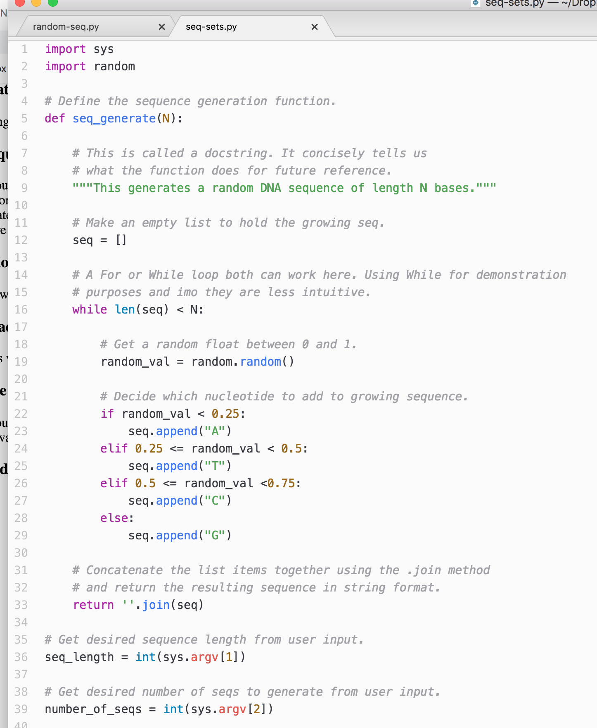
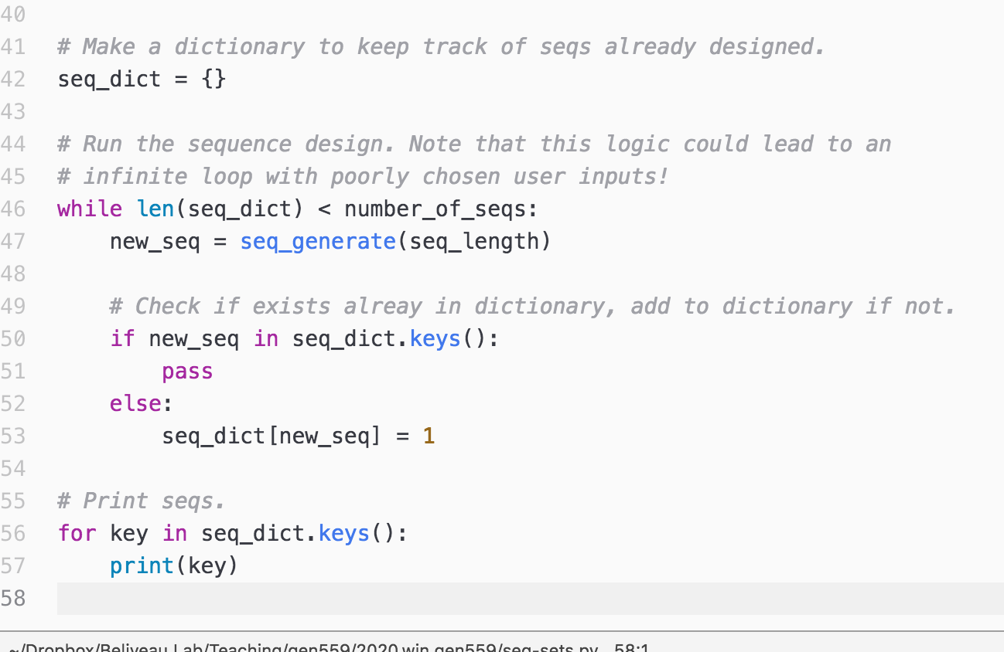
Solution #2 – with comments

