Slide 1
One Minute Responses
Pace good (x2)
Problems we did really helped
I liked the walk-through problem!
Group problem was helpful for logic
I liked solving problems interactively!
Interactive problem was super helpful
I thought the interactive problem was a great idea … helped me realize I should make a plan before I start coding
I liked moving through code together and having more time to spend on code
SUPER helpful to do first practice problem together
Going through a problem together as a class was very helpful
Really enjoyed working through a problem together first
Wish we moved onto more problems
Would like to go a bit faster
Slightly faster than I would like for practice problems
Can you make questions that are closer to the hw problems?

Slide 2
Parsimony
Small Parsimony
Genome 559: Introduction to Statistical and Computational Genomics
Elhanan Borenstein

Slide 3
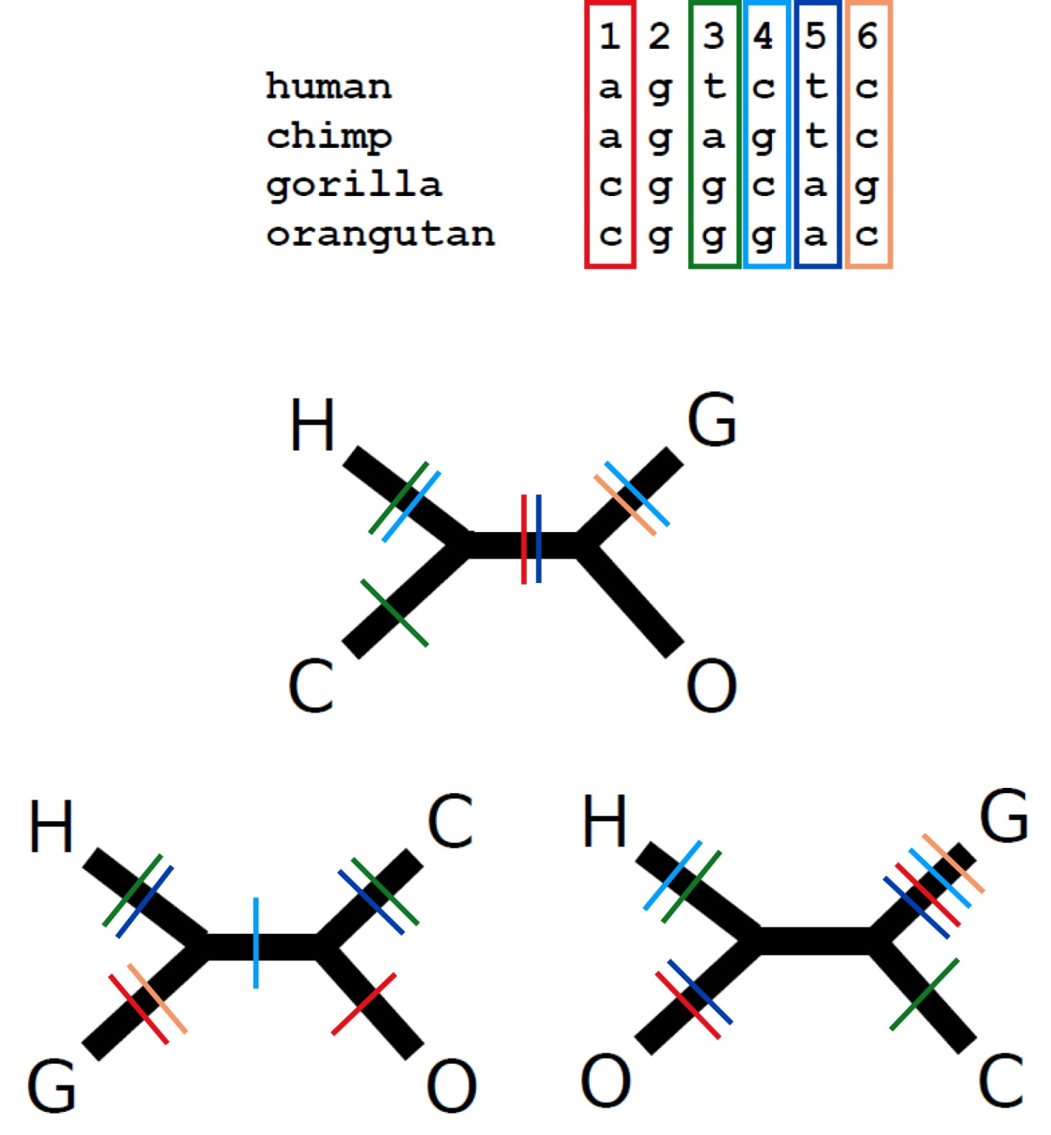
A quick review
The parsimony principle:
  Find the tree that requires the
  fewest evolutionary changes!
A fundamentally different method:
  Search rather than reconstruct
Parsimony algorithm
  Construct all possible trees
  For each site in the alignment and for each tree count the minimal number of changes required
  Add sites to obtain the total number of changes required for each tree
  Pick the tree with the lowest score

Slide 4
A quick review
The parsimony principle:
  Find the tree that requires the
  fewest evolutionary changes!
A fundamentally different method:
  Search rather than reconstruct
Parsimony algorithm
  Construct all possible trees
  For each site in the alignment and for each tree count the minimal number of changes required
  Add sites to obtain the total number of changes required for each tree
  Pick the tree with the lowest score
Too many!
The small parsimony problem

Slide 5
Large vs. Small Parsimony
We divided the problem of finding the most parsimonious tree into two sub-problems:
  Large parsimony: Find the topology which gives best score
  Small parsimony: Given a tree topology and the state in all the tips, find the minimal number of changes required
Divide and conquer. Think functions !!
Large parsimony is “NP-hard”
Small parsimony can be solved
quickly using Fitch’s algorithm
Parsimony Algorithm
Construct all possible trees
For each site in the alignment and for each tree count the minimal number of changes required
Add all sites up to obtain the total number of changes for each tree
Pick the tree with the lowest score

Slide 6
The Small Parsimony Problem
Input:
  A tree topology:
  State assignments for all tips:
Human C A C T
Chimp T A C T
Bonobo A G C C
Gorilla A G C A
Gibbon G A C T
Lemur T A G T
human
chimp
gibbon
lemur
gorilla
bonobo
human
chimp
gibbon
lemur
gorilla
bonobo
C
T
G
T
A
A
Output:
The minimal number of changes required: parsimony score
(but in fact, we will also find the most parsimonious
assignment for all internal nodes)

Slide 7
Fitch’s algorithm
Execute independently for each character:
Two phases:
  Bottom-up phase: Determine the set of possible states for each internal node
  Top-down phase: Pick a state for each internal node
1
2
human
chimp
gibbon
lemur
gorilla
bonobo
C
T
G
T
A
A

Slide 8
1. Fitch’s algorithm: Bottom-up phase
(Determine the set of possible states for each internal node)
Initialization: R_{i} = {s_{i}} for all tips
Traverse the tree from leaves to root (“post-order”)
Determine R_{i} of internal node i with children j, k:
1. Is there overlap between {C} and {T}?
No
1
2. Then R₃ = R₁ + R₂ = {C,T}
C,T
Let s_{i} denote the state of node i and R_{i} the set of possible states of node i
3
1
2
human
chimp
C
T
Notes:
DEFINE S and R

Slide 9
1. Fitch’s algorithm: Bottom-up phase
(Determine the set of possible states for each internal node)
Initialization: R_{i} = {s_{i}} for all tips
Traverse the tree from leaves to root (“post-order”)
Determine R_{i} of internal node i with children j, k:
1. Is there overlap between {C,A} and {A,T}?
Yes
1
2. Then R₃ = overlap(R₁, R₂) = {A}
A
Let s_{i} denote the state of node i and R_{i} the set of possible states of node i
3
1
2
C, A
A,T
Notes:
DEFINE S and R

Slide 10
1. Fitch’s algorithm: Bottom-up phase
(Determine the set of possible states for each internal node)
Initialization: R_{i} = {s_{i}} for all tips
Traverse the tree from leaves to root (“post-order”)
Determine R_{i} of internal node i with children j, k:
T,A
Let s_{i} denote the state of node i and R_{i} the set of possible states of node i
T
1
G,T,A
C,T
G,T
human
chimp
gibbon
lemur
gorilla
bonobo
C
T
G
T
A
A
Notes:
DEFINE S and R

Slide 11
1. Fitch’s algorithm: Bottom-up phase
(Determine the set of possible states for each internal node)
Initialization: R_{i} = {s_{i}} for all tips
Traverse the tree from leaves to root (“post-order“)
Determine R_{i} of internal node i with children j, k:
Parsimony-score =
# union operations
T,A
T
1
G,T,A
C,T
G,T
Parsimony-score = 4
human
chimp
gibbon
lemur
gorilla
bonobo
C
T
G
T
A
A

Slide 12
2. Fitch’s algorithm: Top-down phase
(Pick a state for each internal node)
Pick arbitrary state in R_{root} to be the state of the root ,s_{root}
Traverse the tree from root to leaves (“pre-order”)
Determine s_{i} of internal node i with parent j:
T,A
T
2
G,T,A
C,T
G,T
Parsimony-score = 4
human
chimp
gibbon
lemur
gorilla
bonobo
C
T
G
T
A
A

Slide 13
2. Fitch’s algorithm: Top-down phase
(Pick a state for each internal node)
Pick arbitrary state in R_{root} to be the state of the root ,s_{root}
Traverse the tree from root to leaves (“pre-order”)
Determine s_{i} of internal node i with parent j:
A
T
2
T
T
T
Parsimony-score = 4
human
chimp
gibbon
lemur
gorilla
bonobo
C
T
G
T
A
A

Slide 14
And now back to the “big” parsimony problem …
How do we find the most parsimonious tree amongst the many possible trees?

