Slide 1
Programming:
The Next Step
Genome 559: Introduction to Statistical and Computational Genomics
Elhanan Borenstein
(and Brian Beliveau)

Slide 2
About me
Assistant Prof in Genome Sciences
Training: chemical engineering, molecular bio, genetics, biophysics, (bioinformatics)
Research: technology development, microscopy, 3D genome organization

Slide 3
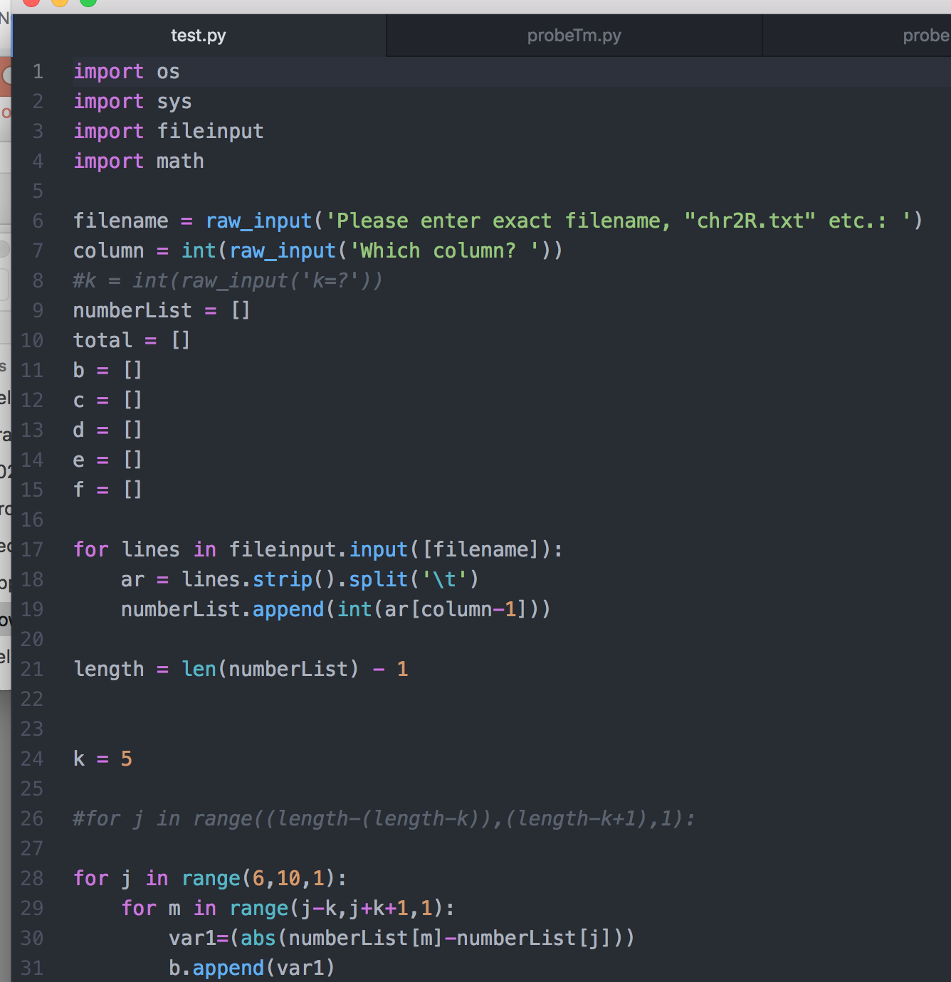
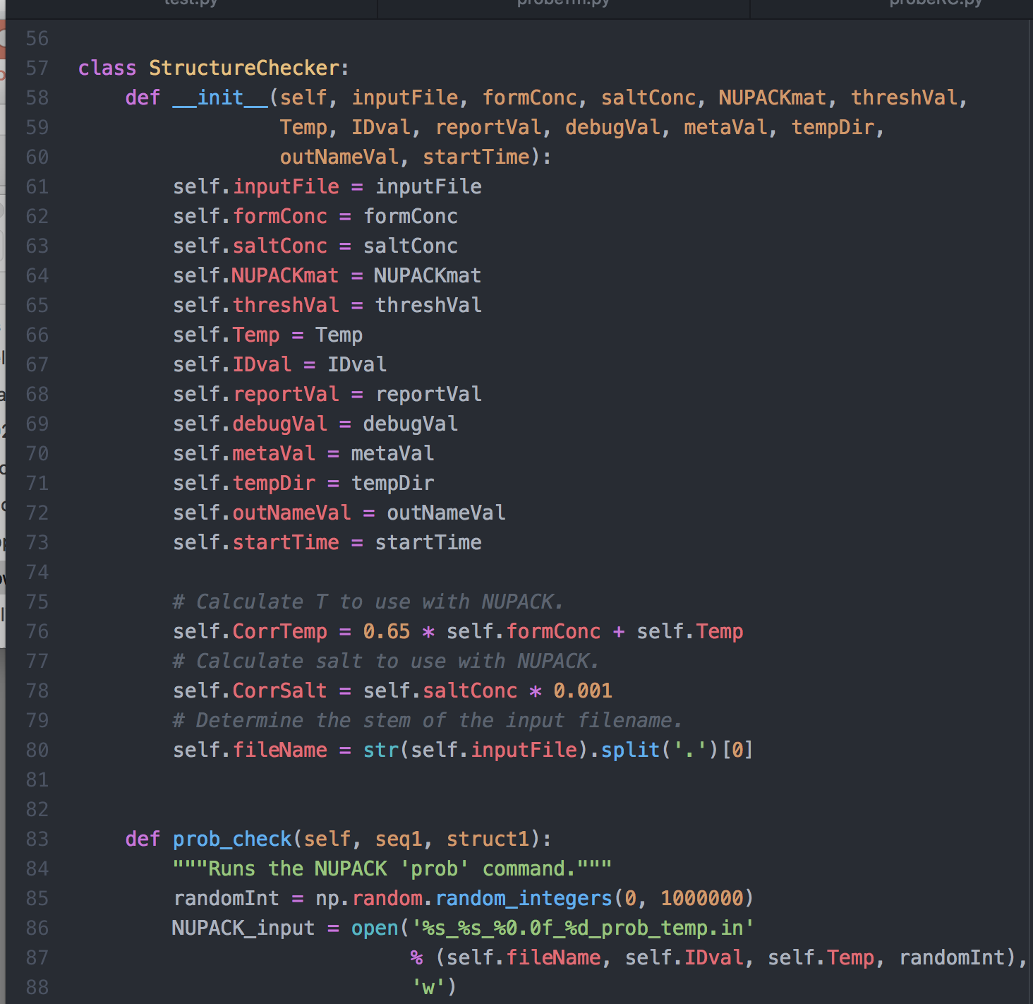

My Python journey
By taking this class, you are already *way* ahead of where I was as a PhD student!!!
2011
2017

Slide 4
A quick review
Dictionaries:
  key:value pairs
  a.k.a. hash tables, lookup tables
  Examples:
    Word and definition
    Name and phone number
    Gene name and score
    Username and password
  Dictionaries are useful when you want to look up some data (value) based on a key
  Each key can appear only once
Standard I/O

Slide 5
Note: dictionary and list access times
Accessing a list by index is very fast!
Accessing a dictionary by key is very fast!
Accessing a list by value (e.g. list.index(myVal) or list.count(myVal)) can be SLOW.
by index:
by value:
4
0 val1
1 val2
2 val3
3 val4
4 val5
…
max last_val
is myVal == val1 ?
0 val1
1 val2
2 val3
3 val4
4 val5
…
max last_val
is myVal == val2 ?
is myVal == val3 ?
is myVal == val4 ?
is myVal == val5 ?
is myVal == last_val ?
(index points directly to position in memory)

Slide 6
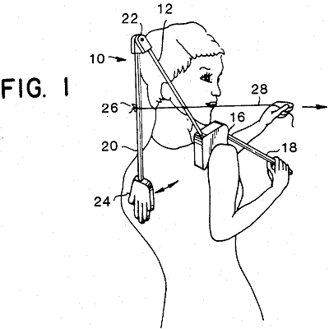

Take a deep breath …
… and think how much you've learned!
4 weeks ago, this would have been gibberish:
import sys
matrixFile = open(sys.argv[1], "r")
matrix = [] # initialize empty matrix
line = matrixFile.readline().strip() # read first line stripped
while len(line) > 0: # until end of file
fields = line.split("\t") # split line on tabs, giving a list of strings
intList = [] # create an int list to fill
for field in fields: # for each field in current line
intList.append(int(field)) # append the int value of field to intList
matrix.append(intList) # after intList is filled, append it to matrix
line = matrixFile.readline().strip() # read next line and repeat loop
matrixFile.close()
for row in matrix: # go through the matrix row by row
for val in row: # go through each value in the row
print val, # print each value without line break
print "" # add a line break after each row

Slide 7
In theory,
what you know so far allows you
to solve any computational task
(“universality”)
So … why don’t we stop here?

Slide 8
most real-life tasks
will be (very) painful to solve
using only what you know so far ...

Slide 9
What are we missing?
A way to generalized procedures …
A way to store and handle complex data …
A way to organize our code …
Better design and coding practices …

Slide 10
Dictionaries practice
Input files can be downloaded from:
beliveau.io/gen559

Slide 11
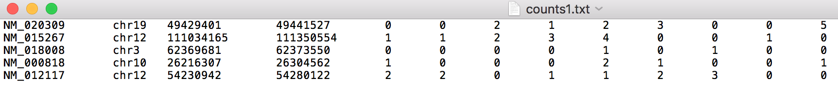
Sample problem #1
Refseq
ID
Chrom
Start
Stop
Each column is a single cell
The file ‘counts1.txt’ contains gene expression data from a single cell RNA sequencing experiment (tab-delimited)
Write a program ‘chroms.py’ that prints how many distinct chromosomes are mapped to in the dataset

Slide 12
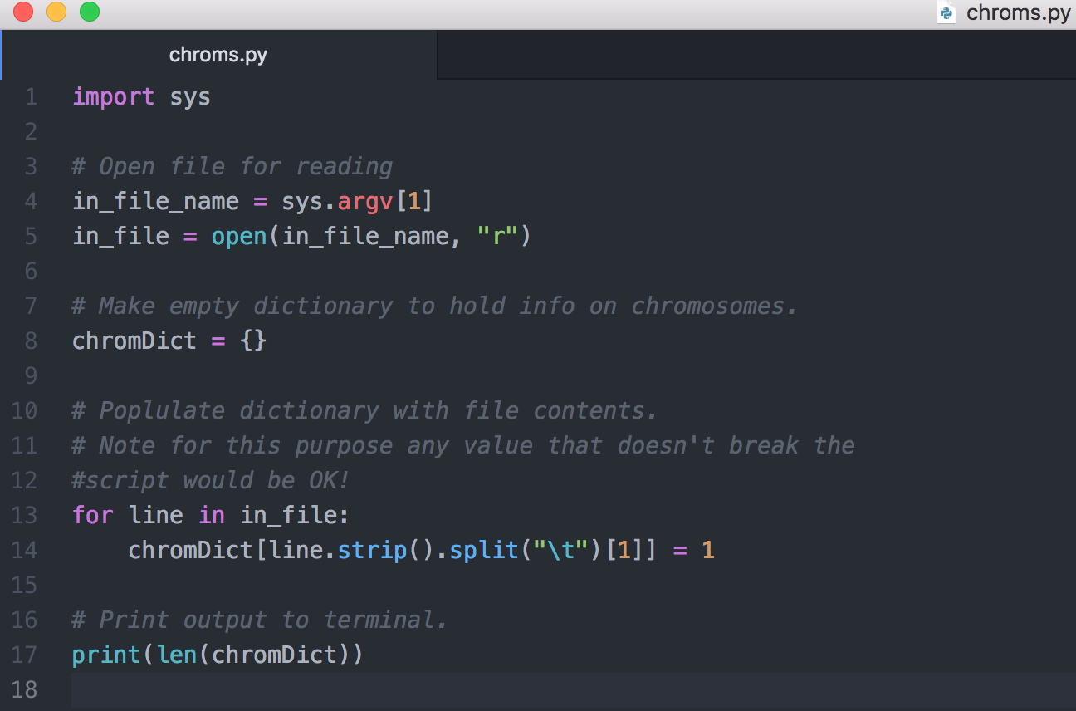
Solution #1

Slide 13
Sample problem #2
Refseq
ID
Chrom
Start
Stop
Each column is a single cell
The file ‘counts2.txt’ has the same format as ‘counts1.txt’
Write a program ‘chrom-counts.py’ that prints to the terminal how many times each chromosome is mapped to in total between the two datasets (counts1 and counts2) in the format “chrom \t count”

Slide 14
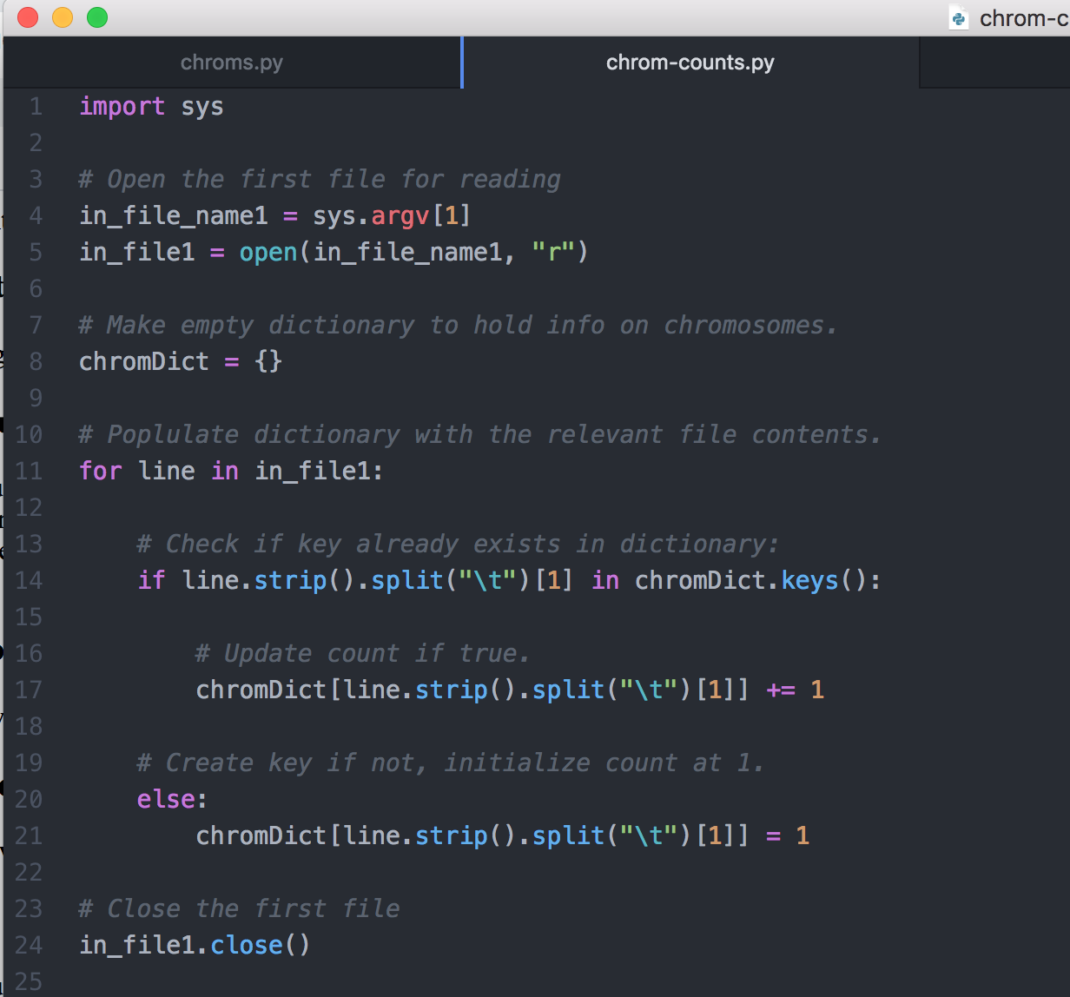
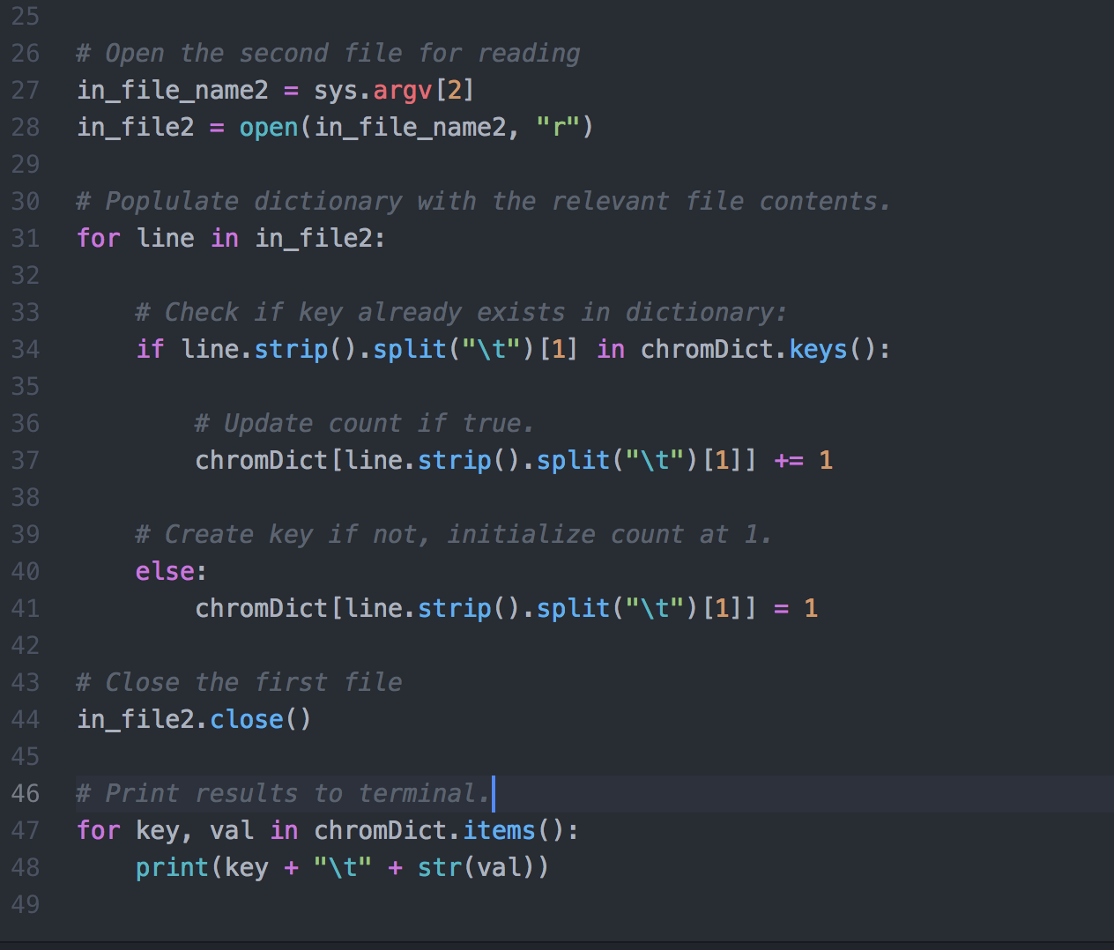
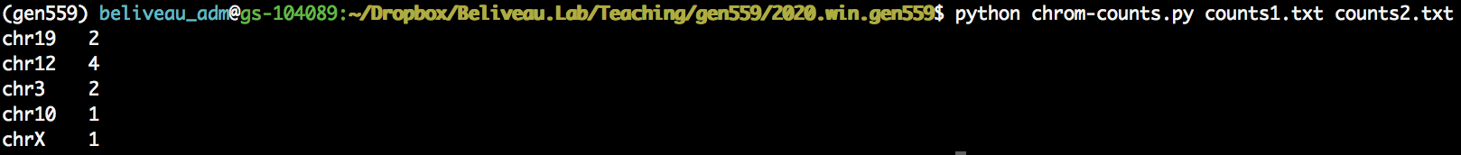
Solution #2

Slide 15
Challenge problem
Refseq
ID
Chrom
Start
Stop
Each column is a single cell
Write a program ‘counts-filter.py’ that prints to the terminal only transcripts whose average expression is >0.5 transcripts per cell in total over the two datasets (counts1 and counts2) in the format “ID \t average expression”

Slide 16
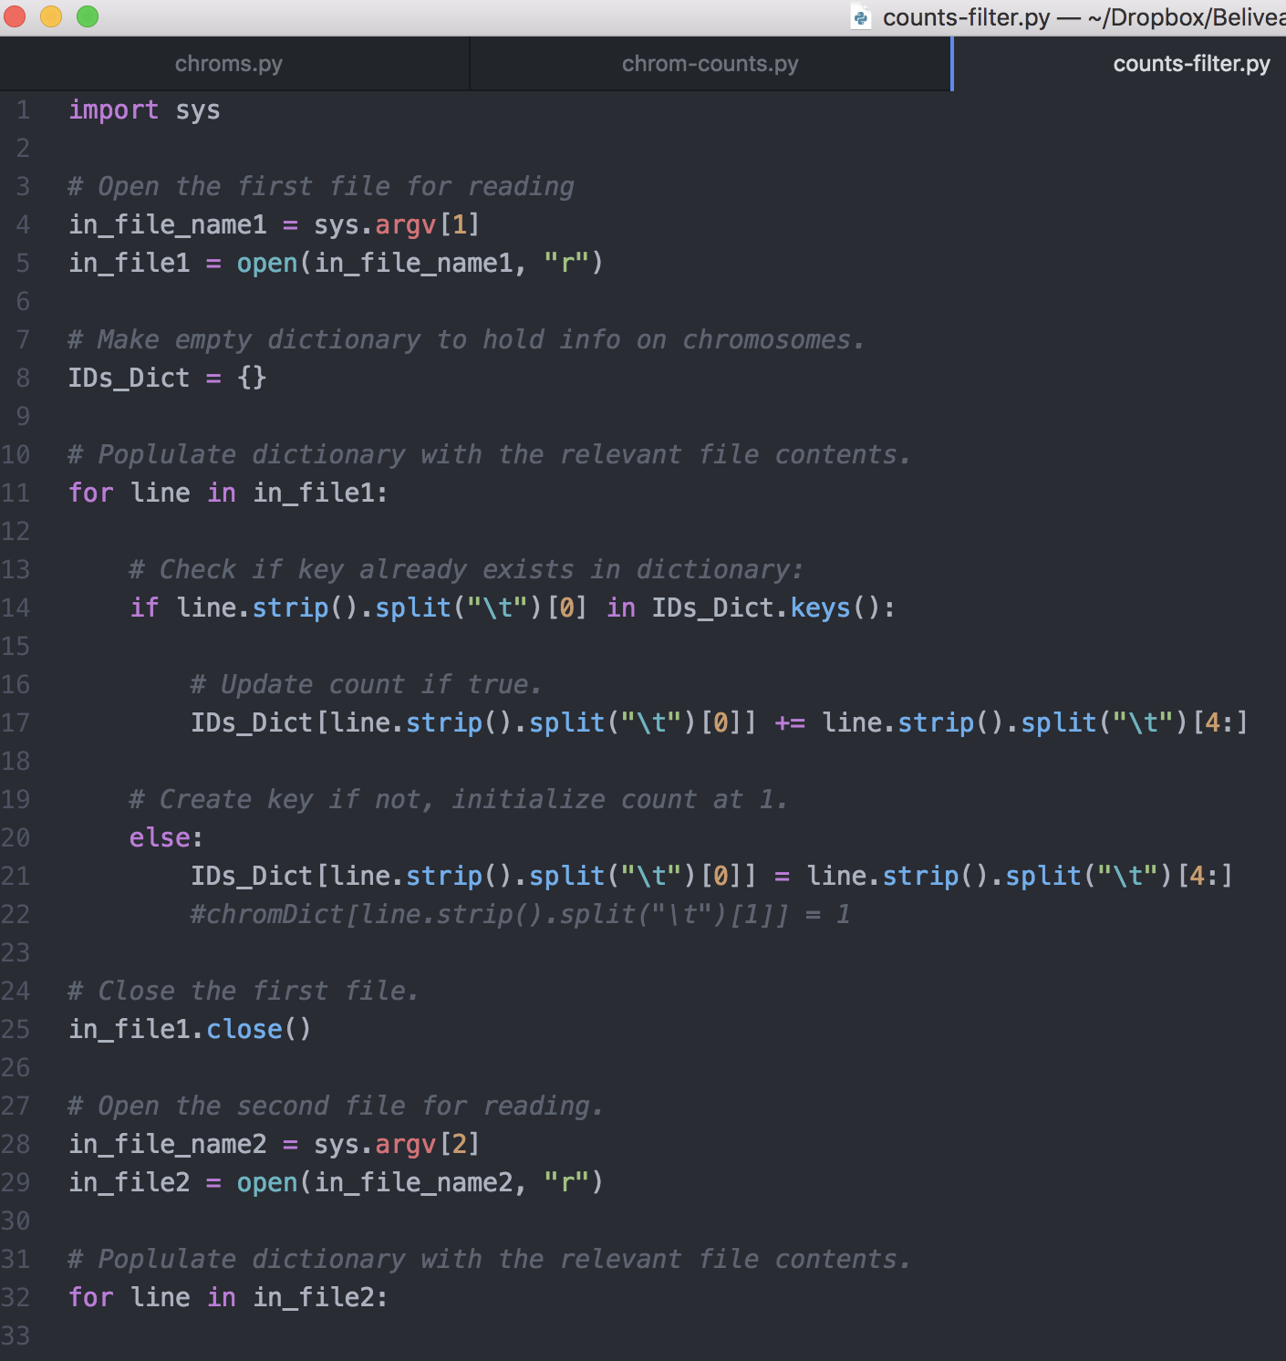
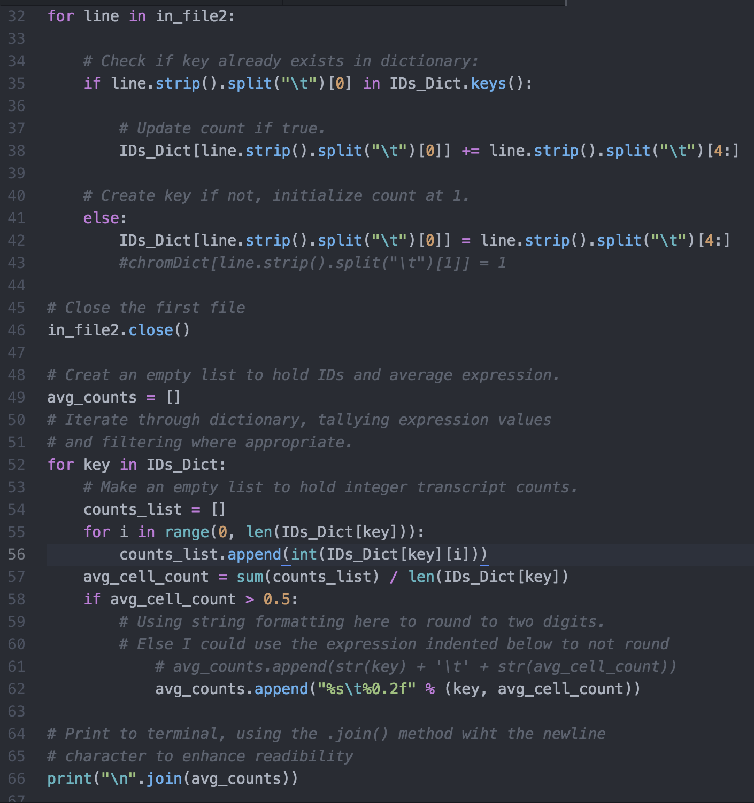
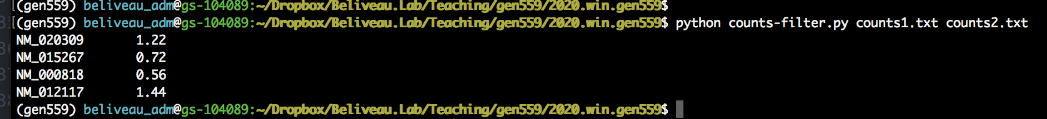
Challenge Solution

