Slide 1
One Minute Responses
Good pace today
Great pace today
Algorithm lecture was good pace and easy to follow
Parsimony now makes sense
Questions on small parsimony were answered
Helped to work through each line on board
I like visual examples on whiteboard
Phew, need to sit down and think about recursion!
Recursive functions seem like they are going to be challenging for awhile
Recursions were conceptually difficult
Still pretty confused about recursions, more time would be good on problems
Would like a bit more work on recursion to get a a handle on it
Recursion is hard
The slides for practice problems asked us to use some things that hadn’t been covered in class (pass-by-function) which was confusing
Also a bit curious about the lion hunting stuff

Slide 2
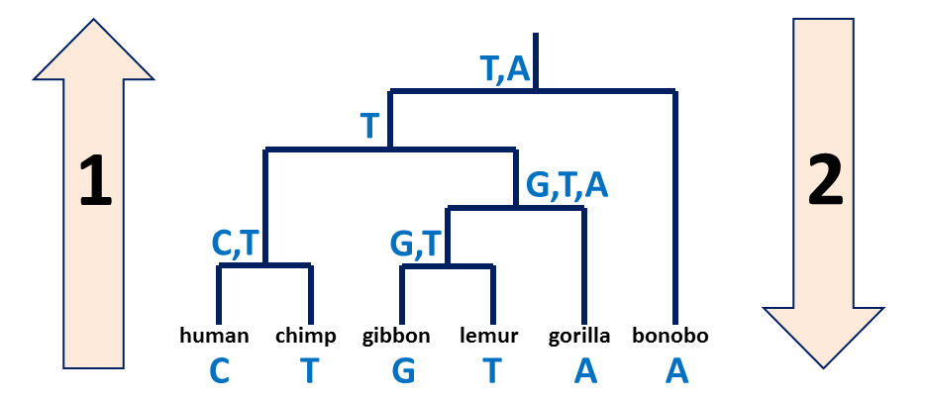
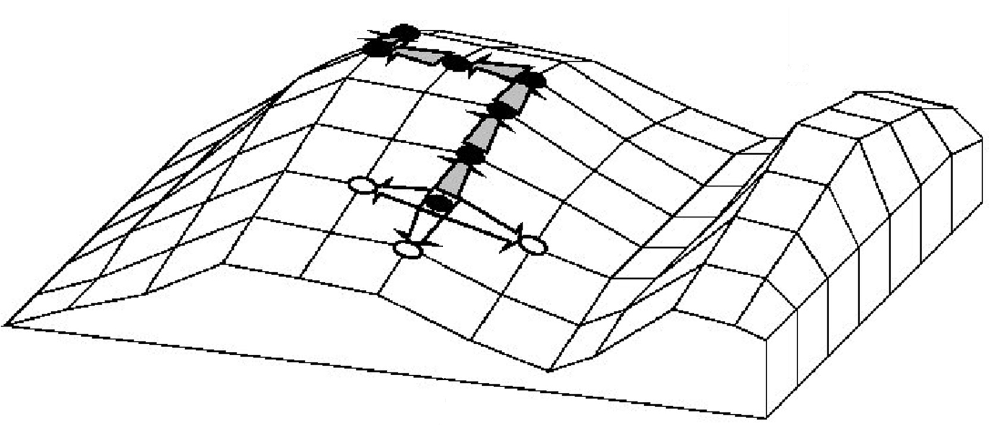
A quick review
Small vs. large parsimony
Fitch’s algorithm:
  Bottom-up phase: Determine the set of possible states
  Top-down phase: Pick a state for each internal node
Searching the tree space:
  Exhaustive search, branch and bound
  Hill climbing w/ Nearest-Neighbor Interchange

Slide 3
Clustering
Genome 559: Introduction to Statistical and Computational Genomics
Elhanan Borenstein
Some slides adapted from Jacques van Helden

Slide 4
A common data structure in
high-throughput biology

Slide 5
A common data structure in
high-throughput biology
Samples
776 | 2905 | 5317 | 3275 | 4580 | 1083 | 2169 | 1817 | 1553 | 1391 | 0 | 0 | 0 | 0 | 410 | 0
77 | 252 | 117 | 162 | 85 | 250 | 415 | 518 | 37 | 314 | 846 | 651 | 218 | 1044 | 480 | 942
70 | 63 | 83 | 164 | 97 | 186 | 196 | 126 | 68 | 216 | 536 | 475 | 114 | 566 | 183 | 376
27 | 31 | 197 | 26 | 157 | 197 | 184 | 67 | 7 | 98 | 677 | 1504 | 345 | 393 | 148 | 93
111 | 367 | 239 | 463 | 508 | 175 | 282 | 77 | 147 | 877 | 0 | 0 | 445 | 447 | 435 | 727
240 | 335 | 136 | 167 | 104 | 78 | 142 | 158 | 657 | 130 | 420 | 123 | 93 | 82 | 592 | 158
806 | 45 | 49 | 6 | 27 | 31 | 67 | 55 | 18 | 65 | 86 | 294 | 24 | 157 | 152 | 386
0 | 100 | 154 | 176 | 426 | 144 | 167 | 6 | 128 | 193 | 144 | 171 | 1101 | 392 | 92 | 149
24 | 156 | 813 | 679 | 374 | 565 | 573 | 0 | 262 | 772 | 456 | 514 | 1461 | 620 | 137 | 36
86 | 163 | 8 | 55 | 0 | 47 | 21 | 239 | 63 | 74 | 706 | 196 | 146 | 0 | 175 | 326
0 | 0 | 0 | 5 | 29 | 119 | 28 | 0 | 0 | 0 | 173 | 361 | 0 | 0 | 0 | 20
919 | 635 | 0 | 10 | 108 | 0 | 5 | 30 | 17 | 0 | 116 | 176 | 45 | 21 | 384 | 2
51 | 154 | 36 | 0 | 48 | 129 | 95 | 30 | 0 | 54 | 168 | 143 | 86 | 357 | 53 | 33
516 | 3 | 114 | 109 | 186 | 54 | 6 | 199 | 565 | 118 | 0 | 14 | 0 | 0 | 378 | 163
70 | 63 | 83 | 164 | 97 | 186 | 196 | 126 | 68 | 216 | 536 | 475 | 114 | 566 | 183 | 376
27 | 31 | 197 | 26 | 157 | 197 | 184 | 67 | 7 | 98 | 677 | 1504 | 345 | 393 | 148 | 93
111 | 367 | 239 | 463 | 508 | 175 | 282 | 77 | 147 | 877 | 0 | 0 | 445 | 447 | 435 | 727
240 | 335 | 136 | 167 | 104 | 78 | 142 | 158 | 657 | 130 | 420 | 123 | 93 | 82 | 592 | 158
806 | 45 | 49 | 6 | 27 | 31 | 67 | 55 | 18 | 65 | 86 | 294 | 24 | 157 | 152 | 386
0 | 100 | 154 | 176 | 426 | 144 | 167 | 6 | 128 | 193 | 144 | 171 | 1101 | 392 | 92 | 149
24 | 156 | 813 | 679 | 374 | 565 | 573 | 0 | 262 | 772 | 456 | 514 | 1461 | 620 | 137 | 36
86 | 163 | 8 | 55 | 0 | 47 | 21 | 239 | 63 | 74 | 706 | 196 | 146 | 0 | 175 | 326
0 | 0 | 0 | 5 | 29 | 119 | 28 | 0 | 0 | 0 | 173 | 361 | 0 | 0 | 0 | 20
919 | 635 | 0 | 10 | 108 | 0 | 5 | 30 | 17 | 0 | 116 | 176 | 45 | 21 | 384 | 2
Biological
Entities

Slide 6
A common data structure in
high-throughput biology
Expression
Abundance
Count
Rate
…
Samples
Conditions
Stimuli
Time points
Tissues
Disease states
Locations
Cell types
…
Samples
776 | 2905 | 5317 | 3275 | 4580 | 1083 | 2169 | 1817 | 1553 | 1391 | 0 | 0 | 0 | 0 | 410 | 0
77 | 252 | 117 | 162 | 85 | 250 | 415 | 518 | 37 | 314 | 846 | 651 | 218 | 1044 | 480 | 942
70 | 63 | 83 | 164 | 97 | 186 | 196 | 126 | 68 | 216 | 536 | 475 | 114 | 566 | 183 | 376
27 | 31 | 197 | 26 | 157 | 197 | 184 | 67 | 7 | 98 | 677 | 1504 | 345 | 393 | 148 | 93
111 | 367 | 239 | 463 | 508 | 175 | 282 | 77 | 147 | 877 | 0 | 0 | 445 | 447 | 435 | 727
240 | 335 | 136 | 167 | 104 | 78 | 142 | 158 | 657 | 130 | 420 | 123 | 93 | 82 | 592 | 158
806 | 45 | 49 | 6 | 27 | 31 | 67 | 55 | 18 | 65 | 86 | 294 | 24 | 157 | 152 | 386
0 | 100 | 154 | 176 | 426 | 144 | 167 | 6 | 128 | 193 | 144 | 171 | 1101 | 392 | 92 | 149
24 | 156 | 813 | 679 | 374 | 565 | 573 | 0 | 262 | 772 | 456 | 514 | 1461 | 620 | 137 | 36
86 | 163 | 8 | 55 | 0 | 47 | 21 | 239 | 63 | 74 | 706 | 196 | 146 | 0 | 175 | 326
0 | 0 | 0 | 5 | 29 | 119 | 28 | 0 | 0 | 0 | 173 | 361 | 0 | 0 | 0 | 20
919 | 635 | 0 | 10 | 108 | 0 | 5 | 30 | 17 | 0 | 116 | 176 | 45 | 21 | 384 | 2
51 | 154 | 36 | 0 | 48 | 129 | 95 | 30 | 0 | 54 | 168 | 143 | 86 | 357 | 53 | 33
516 | 3 | 114 | 109 | 186 | 54 | 6 | 199 | 565 | 118 | 0 | 14 | 0 | 0 | 378 | 163
70 | 63 | 83 | 164 | 97 | 186 | 196 | 126 | 68 | 216 | 536 | 475 | 114 | 566 | 183 | 376
27 | 31 | 197 | 26 | 157 | 197 | 184 | 67 | 7 | 98 | 677 | 1504 | 345 | 393 | 148 | 93
111 | 367 | 239 | 463 | 508 | 175 | 282 | 77 | 147 | 877 | 0 | 0 | 445 | 447 | 435 | 727
240 | 335 | 136 | 167 | 104 | 78 | 142 | 158 | 657 | 130 | 420 | 123 | 93 | 82 | 592 | 158
806 | 45 | 49 | 6 | 27 | 31 | 67 | 55 | 18 | 65 | 86 | 294 | 24 | 157 | 152 | 386
0 | 100 | 154 | 176 | 426 | 144 | 167 | 6 | 128 | 193 | 144 | 171 | 1101 | 392 | 92 | 149
24 | 156 | 813 | 679 | 374 | 565 | 573 | 0 | 262 | 772 | 456 | 514 | 1461 | 620 | 137 | 36
86 | 163 | 8 | 55 | 0 | 47 | 21 | 239 | 63 | 74 | 706 | 196 | 146 | 0 | 175 | 326
0 | 0 | 0 | 5 | 29 | 119 | 28 | 0 | 0 | 0 | 173 | 361 | 0 | 0 | 0 | 20
919 | 635 | 0 | 10 | 108 | 0 | 5 | 30 | 17 | 0 | 116 | 176 | 45 | 21 | 384 | 2
Biological
Entities
Genes
Proteins
Transcripts
Species
….

Slide 7
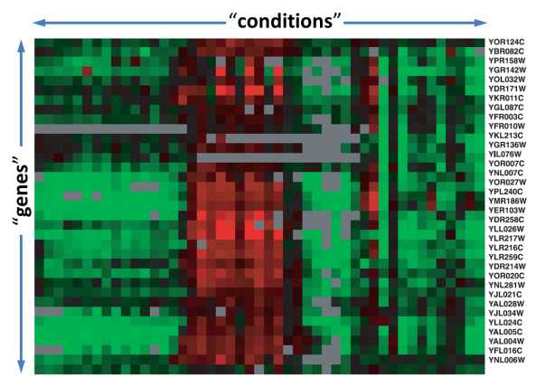
A common data structure in
high-throughput biology
gene x
[0.1, 0.0, 0.6, 1.0, 2.1, 0.4, 0.2, 0.3, 0.5, 0.1, 2.1]
gene y
[0.2, 1.0, 0.8, 0.4, 1.4, 0.5, 0.3, 2.1, 1.2, 3.4, 0.1]

Slide 8
The clustering problem
gene x
[0.1, 0.0, 0.6, 1.0, 2.1, 0.4, 0.2, 0.3, 0.5, 0.1, 2.1]
gene y
[0.2, 1.0, 0.8, 0.4, 1.4, 0.5, 0.3, 2.1, 1.2, 3.4, 0.1]

Slide 9
The clustering problem
The goal of gene clustering process is to partition the genes into distinct sets such that genes that are assigned to the same cluster are “similar”, while genes assigned to different clusters are “non-similar”.
gene x
[0.1, 0.0, 0.6, 1.0, 2.1, 0.4, 0.2, 0.3, 0.5, 0.1, 2.1]
gene y
[0.2, 1.0, 0.8, 0.4, 1.4, 0.5, 0.3, 2.1, 1.2, 3.4, 0.1]

Slide 10
The clustering problem
A good clustering solution should have two features:
  High homogeneity: homogeneity measures the similarity between genes assigned to the same cluster.
  High separation: separation measures the distance/dis-similarity between clusters.
  (If two clusters have similar expression patterns, then they should probably be merged into one cluster).

Slide 11
Why clustering

Slide 12
Why clustering
Clustering genes or conditions is a basic tool for the analysis of expression profiles, and can be useful for many purposes, including:
  Inferring functions of unknown genes
  (assuming a similar expression pattern implies a similar function).
  Identifying disease profiles
  (tissues with similar pathology should yield similar expression profiles).
  Deciphering regulatory mechanisms: co-expression of genes may imply co-regulation.
  Reducing dimensionality.

Slide 13
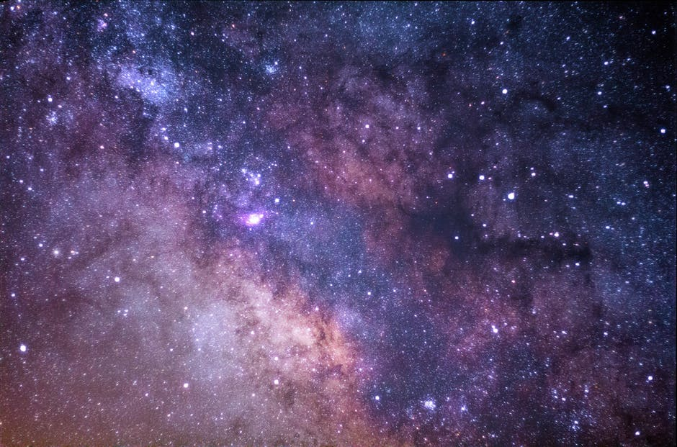
Why is clustering a
hard computational problem?

Slide 14
One problem, numerous solutions
Many algorithms:
  Hierarchical clustering
  k-means
  self-organizing maps (SOM)
  Knn
  PCC
  CLICK
There are many formulations of the clustering problem
The results (i.e., obtained clusters) can vary drastically depending on:
  Clustering method
  Parameters specific to each clustering method (e.g. number of centers for the k-mean method, agglomeration rule for hierarchical clustering, etc.)

Slide 15
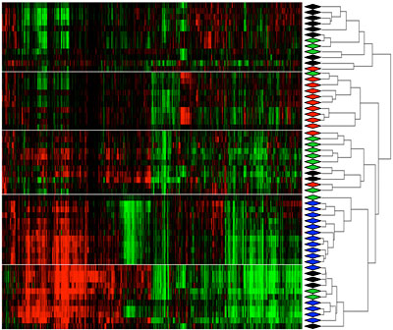
Different views of clustering …

Slide 16
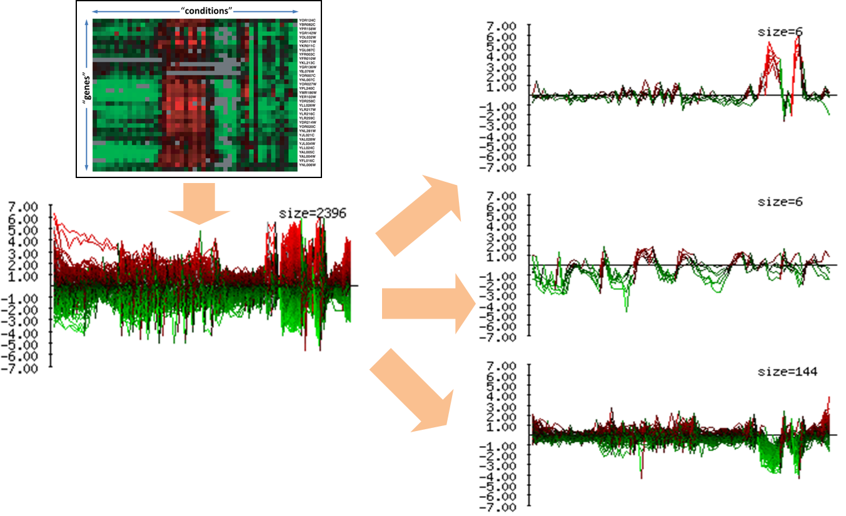
Different views of clustering …

Slide 17
Different views of clustering …

Slide 18
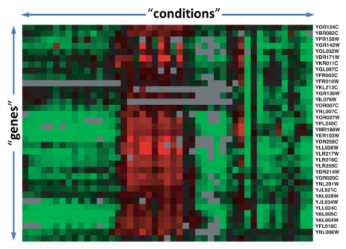
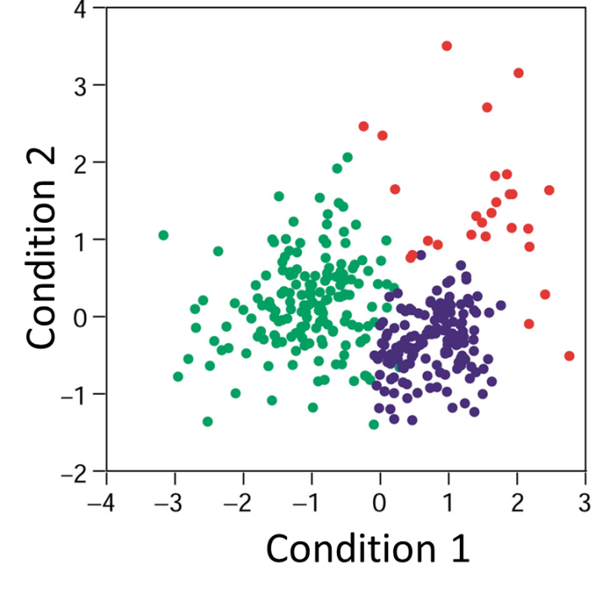
Different views of clustering …

Slide 19
Different views of clustering …

Slide 20
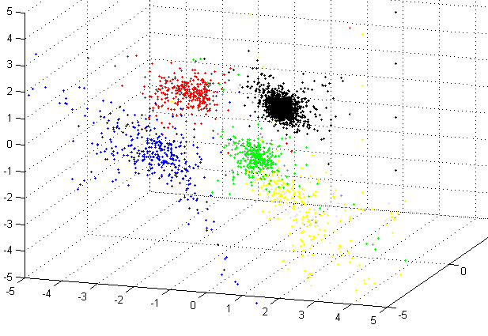
Different views of clustering …

Slide 21

Measuring similarity/distance
An important step in many clustering methods is the selection of a distance measure (metric), defining the distance between 2 data points (e.g., 2 genes)
“Point” 1
: [0.1 0.0 0.6 1.0 2.1 0.4 0.2]
“Point” 2
: [0.2 1.0 0.8 0.4 1.4 0.5 0.3]
Genes are points in the
multi-dimensional space R^{n}
(where n denotes the
number of conditions)

Slide 22
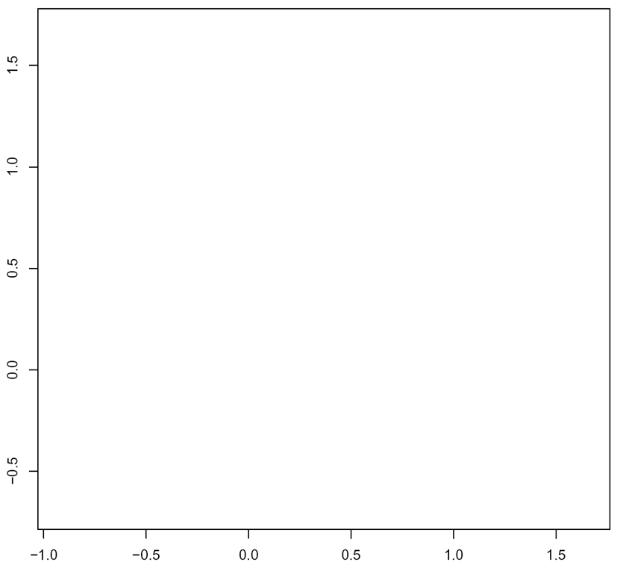
Measuring similarity/distance
So … how do we measure the distance between two point in a multi-dimensional space?
B
A

Slide 23

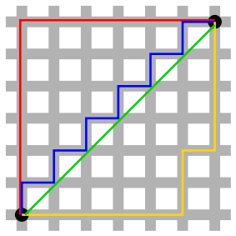
Measuring similarity/distance
So … how do we measure the distance between two point in a multi-dimensional space?
Common distance functions:
  The Euclidean distance
  (a.k.a “distance as the crow flies” or distance).
  The Manhattan distance
  (a.k.a taxicab distance)
  Hamming distance
  (a.k.a edit distance)
  Correlation (Pearson, Spearman, Absolute Value of Correlation, etc.)

